Slide 1
MassHealth Updates
Massachusetts Health Care Training Forum
October 2020

Slide 2
Agenda
MassHealth’s Response to COVID-19 Operations Update
MassHealth Family Assistance: Covered Service Expansion
Notice of Birth Update
Home and Community Based Service Waiver (HCBS)
Medicare Savings Program (MSP) for Home and Community Based Service Waiver (HCBS)
MassHealth Renewal Updates
Reporting Income Change
IRS Economic Impact Payments for non-filers Update
COVID-19 Resources

Slide 3
MassHealth Operations Update:
Response to COVID-19

Slide 4
Response to COVID-19 Health Emergency (slide 1 of 2)
The Secretary of Health and Human Services, Alex Azar, extended the COVID-19 national public health emergency declaration, effective October 23, 2020. This extension is for 90 days.
In response to COVID-19, and to support the health and safety of our members and staff:
All MassHealth Enrollment Centers (MECs) will be closed for walk-in visitors until the federal emergency is lifted.
The MassHealth Customer Service Center has maintained regular business hours, though wait times may vary.

Slide 5
Response to COVID-19 Health Emergency (slide 2 of 2)
MassHealth will maintain coverage for individuals who have:
  MassHealth (Medicaid/CHIP) coverage, Children’s Medical Security Plan (CMSP), or Health Safety Net (HSN) as of March 18, 2020
  been newly approved during the COVID-19 public health national emergency, and through the end of the month in which such national emergency period ends
Individuals will not lose coverage or have a decrease in benefits during the public health national emergency. Coverage will end only if an individual:
  requests termination of eligibility
  is no longer a resident of Massachusetts
  is deceased
MassHealth Eligibility Flexibilities for COVID-19
Notes:
TP: MH Elig. Flexibilities for COVID-19 was updated in August. Updates to highlight, as it’s caused confusion and this is directly from the summary document, include:
Retroactive Eligibility for Individuals Under the Age of 65: Upon request initial applicants under the age of 65 who applied on or after March 1, 2020, will have their coverage be retroactive to as early as the first day of the third calendar month before the month of application, but no earlier than March 1, 2020.
If a member’s eligibility has been closed for more than 90 days and a new application was submitted to MassHealth, retroactive eligibility can be requested. If a member’s eligibility has been closed for less than 90 days at the time that MassHealth receives their new application, this is not considered an initial application and the request for retroactive eligibility cannot be honored. Individuals over the age of 65 can continue to request retroactive coverage as they do today.
Self-attestation for Eligibility Factors
MassHealth will accept self-attestation for all eligibility factors, except citizenship and immigration, from all individuals if we are unable to match electronically and documentation is not readily accessible to the individual.
Standard application processes will be maintained meaning:
• MassHealth will still use electronic data matching to verify eligibility factors at time of application.
• Requests for Information (RFI/VC-1) will be generated when eligibility factors cannot be verified at time of application.
For instance, if an ACA-3 application was completed over the phone, the application will still go through the normal processing of data matching to verify elig. factors and

Slide 6
MassHealth Family Assistance: Covered Service Expansions

Slide 7





Current Eligibility Summary
Member Categories
Children and Young Adults
Adults
HIV Positive Adults
Disabled Adults

Slide 8




Current Covered Services
Medical services:
lab tests, X rays, therapies, pharmacy services, eyeglasses, hearing aids, medical equipment and supplies
Ambulance services (emergency only)
Inpatient hospital and Outpatient services
MassHealth Family Assistance
Well-child screenings (for children under 21) medical, vision, dental, hearing, behavioral health, developmental screens, as well as shots
Home health services
Behavioral health (mental health and addiction) services
Services to help you quit smoking

Slide 9
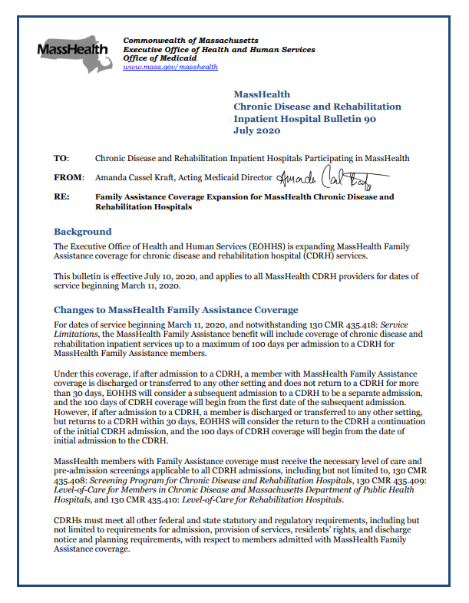
Covered Services Expansion
(slide 1 of 2)
The Executive Office of Health and Human Services (EOHHS) is expanding MassHealth Family Assistance coverage for chronic disease and rehabilitation hospital (CDRH) services.
Effective July 10, 2020 and applies to all MassHealth CDRH for dates of service beginning March 11, 2020.
9

Slide 10
Covered Services Expansion
(slide 2 of 2)
The Executive Office of Health and Human Services (EOHHS) is expanding MassHealth Family Assistance coverage for nursing facility services.
Effective July 10, 2020 and applies to all MassHealth nursing facility providers for dates of service beginning March 11, 2020.
10

Slide 11
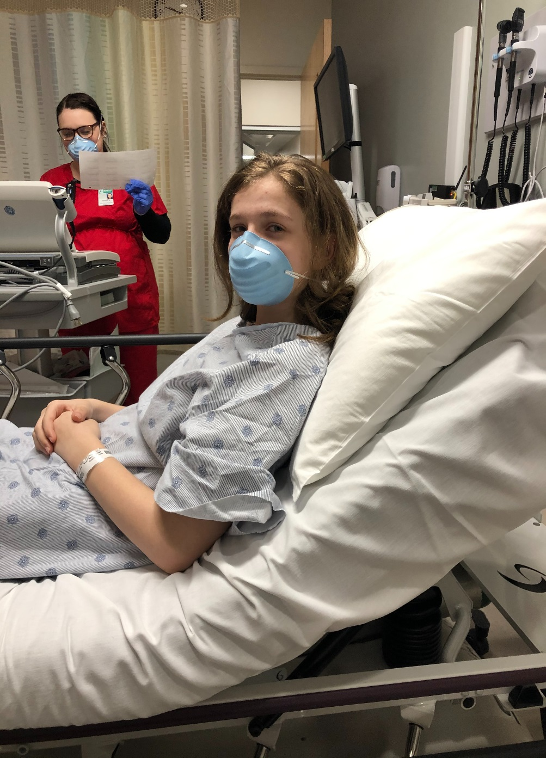
CDRH and Nursing Facility Operations Process (slide 1 of 5)
Inpatient services for up to 100 days per admission
The facility needs to send both an SC-1 form that is marked short-term and is signed by a physician, along with the clinical eligibility approval form stating short-term approval, to MassHealth at: mhpp.ops@state.ma.us
A CDRH/nursing facility payment segment is established in MMIS for the individual at the facility
The long-term care segment is closed

Slide 12
CDRH and Nursing Facility Operations Process (slide 2 of 5)
Inpatient services over 100 days per admission
If the 100-day short-term period expires and the member is still a patient at the facility or is no longer on a short-term stay, the following process will take place:
The payment segment is closed by MassHealth
MassHealth will send the Expiration of Short-Term Stay and Home Maintenance Needs Allowance (ST-CL) cover letter and a SACA-2 to be completed by the facility on behalf of the member. (If the member is under the age of 65, a SACA-2 form will also be sent to the nursing facility.)

Slide 13
CDRH and Nursing Facility Operations Process (slide 3 of 5)
Inpatient services over 100 days per admission
If the 100-day short-term period expires and the member is still a patient at the facility or is no longer on a short-term stay, the following process will take place:
The completed forms must be returned to MassHealth with an SC-1 form, stating that the member is transitioning from short-term to a stay of more than 100- days
A new level-of-care determination form is not needed
If this process is not completed by the nursing facility, the member will not be coded for payment

Slide 14
CDRH and Nursing Facility Operations Process (slide 4 of 5)
Inpatient services over 100 days per admission
If the 100-day short-term period expires and the member does not have a verified immigration status on file that would allow them to be found eligible for MassHealth Standard for long-term-care residents, the following process will happen:
The payment segment will close
MassHealth will send the member a “Benefit Expiration Notice with appeal rights” stating that the member’s verified immigration status does not allow the member to be found eligible for MassHealth Standard for long-term-care residents

Slide 15
CDRH and Nursing Facility Operations Process (slide 5 of 5)
Inpatient services over 100 days per admission
If the 100-day short-term period expires and the member does not have a verified immigration status on file that would allow them to be found eligible for MassHealth Standard for long-term-care residents, the following process will happen:
The notice will state that the member will remain in the Family Assistance benefit and that a change of circumstances affecting eligibility, including immigration status, should be reported within ten days.

Slide 16
Resource
For more information, go to:
MassHealth Eligibility Operations Memo:
EOM 20-15: Permanent Family Assistance Coverage Expansion for MassHealth Chronic Disease and Rehabilitation Hospitals and Nursing Facilities
All Provider Bulletin:
Nursing Facility Bulletin 149: Family Assistance Coverage Expansion for Nursing Facility Services
Chronic Disease and Rehabilitation Inpatient Hospital Bulletin 90: Family Assistance Coverage Expansion for MassHealth Chronic Disease and Rehabilitation Hospitals

Slide 17
Home and Community Based Service Waiver (HCBSW)

Slide 18

Home and Community Base Service Waiver
  MassHealth works with other state agencies to administer the Home and Community Based Services Waivers (HCBSW).
  Home and Community Based Services Waivers are:
Acquired Brain Injury (ABI) – Non-Residential Waiver | Acquired Brain Injury (ABI) –Residential Habilitation Waiver
Adult Supports Waiver | Children’s Autism Spectrum Disorders Waiver
Community Living waiver | Frail Elders Waiver
HCBS Waiver for Adults with an Intellectual Disability | Moving Forward Plan (renamed from Money Follows the Person) (MFP) Residential Support Waiver
Moving Forward Plan (MFP) Community Living Waiver | Traumatic Brain Injury Waiver
Notes:
MRC operates three waivers:
Traumatic Brain Injury Waiver (TBI Waiver)
Acquired Brain Injury Non-Residential Waiver (ABI-N Waiver)
Moving Forward Plan Community Living Waiver (MFP-CL Waiver)
Two other related waivers are operated by the Department of Developmental Services:
Acquired Brain Injury Residential Habilitation Waiver (ABI-RH Waiver)
Moving Forward Plan Residential Supports Waiver (MFP-RS Waiver)
The ABI and the MFP waivers can only be entered from a nursing or rehab hospital facility. People in the community with a Traumatic Brain Injury can become eligible for the TBI waiver.
Home and Community Based Waivers
Acquired Brain Injury – Non-Residential Waiver – This program helps people eligible for MassHealth with acquired brain injury (ABI) to move back to the community from a facility setting and receive community-based services. The program provides services to individuals who can move to their own home or apartment or to the home of someone else. This can include participants receiving Adult Foster Care services. The program is operated by the Massachusetts Rehabilitation Commission.
Acquired Brain Injury- Residential Waiver – This program helps people eligible for MassHealth with acquired brain injury (ABI) to move back to the community from a facility setting and receive community-based services. The program provides services to individuals who need supervision and staff support 24 hours a day, seven days a week in a residential setting. Residential support services can include living in a group home with up to 4 individuals, an assisted living residence, or shared living with 24 hour supports. The program is operated by the Department of Developmental Services.
Adult Supports Waiver – This program provides community support for people eligible for MassHealth with an intellectual disability. It supports people who can live in their family home, in the home of someone else, or their own home and who do not need supervision 24 hours a day, seven days a week. The Adult Supports Waiver is operated by the Department of Developmental Services.
Children’s Autism Spectrum Disorders Waiver - This program provides intensive in-home and other services to children with autism covered by MassHealth. The Children’s Autism Waiver is operated by the Department of Developmental Services.
Community Living Waiver – This program provides supportive services to people eligible for MassHealth with an intellectual disability who can live in their family home, in the home of someone else, or their own home, and who do not need supervision 24 hours a day, seven days a week. The program is operated by the Department of Developmental Services.
Frail Elder Waiver - This program helps people age 60 and older covered by MassHealth to receive health care and support services in their homes. It is for people who would meet the criteria for nursing home care but prefer to live in the community. The program supports elders through services to assist with self-care and everyday tasks. The Frail Elder Waiver is operated by the Executive Office of Elder Affairs Home Care Program.
Intensive Supports Waiver – This program provides flexible and necessary supports and services to adults eligible for MassHealth with an intellectual disability who require supervision and access to support 24 hours a day, 7 days per week. People in this program may reside in out-of-home residential settings or in their family home with a comprehensive array of supports. The Intensive Supports Waiver is operated by the Department of Developmental Services.
Money Follow the Person (MFP) Residential Supports Waiver - This program helps adults eligible for MassHealth to move back to the community from a facility setting and receive community-based services. Qualified community residences include supervision and staffing 24 hours a day, seven days a week in a home with up to 4 residents. This program is operated by the Department of Developmental Services.
Money Follow the Person (MFP) Community Living Waiver - This program helps adults eligible for MassHealth move back to the community from a facility setting to live in a qualified residence and receive community-based services. This program is operated by the Massachusetts Rehabilitation Commission.
Traumatic Brain Injury (TBI) Waiver – This program provides community services to people eligible for MassHealth with a traumatic brain injury who meet the criteria for nursing facility or hospital care but prefer to live in the community. The program provides individuals with a traumatic brain injury the support services they need to live safely in their homes and the community. The TBI Waiver is operated by the Massachusetts Rehabilitation Commission.

Slide 19
Home and Community Base Service Waiver (slide 1 of 3)
To participate in any of the HCBS waivers individuals must be eligible for MassHealth Standard and meet clinical and financial eligibility requirements.
Waiver applicants and members must have countable income less than or equal to 300% FPL.
MassHealth will count the assets of the waiver applicant and the spouse but counts the income of waiver applicant only.

Slide 20
Home and Community Base Service Waiver (slide 2 of 3)
Eligible individuals may enroll in only one HCBS waiver at a time and waiver participants are not permitted to enroll in PACE, One Care, or SCO (except for participants who are 65 years and older and enrolled in the Frail Elder Waiver).
Individuals pending a complete application review for HCBS Waivers or PACE may qualify for HSN Presumptive Determination through a qualified hospital or Community Health Center for the interim period.

Slide 21
Home and Community Base Service Waiver (slide 3 of 3)
To apply for MassHealth through the Home and Community Based Services Waiver, only fill out the “Resource Transfers” section of the Supplement A: Long-Term-Care form (found in the Senior Application, SACA-2).
Mail to: MassHealth Enrollment Center
P.O. Box 290794
Charlestown, MA 02129-0214
Fax to: (617) 887-8799
Notes:
NOTES: If applicants are applying for MassHealth through the Kaileigh Mulligan or PACE programs, the applicant does not have to fill out the Long-Term Care Supplement.

Slide 22
Medicare Savings Program (MSP) Update:
HCBSW

Slide 23
Medicare Savings Programs (MSP) Update
Medicare Savings Programs (MSP) (Phase 1) expansion implemented on January 1, 2020 included applying higher income and asset guidelines for applicants/members who are eligible for Buy-In only.
Updates have been made to include approximately 3,500 individuals who participate in a Home and Community Base Service Waiver (HCBSW) and are within the new guidelines.
Start dates will be applied retroactively if appropriate, please note the earliest retroactive start date is 1/1/2020. The impacted members will be re-determined, and retroactive coverage will be applied.
Members will be notified of their enhanced benefits.

Slide 24
MassHealth Renewals Update

Slide 25

MassHealth Auto-Renewals
Auto-Renewals
Certain MassHealth members meet the criteria for autorenewal and are not required to complete a renewal application.
This includes the following:
  Express Lane Renewal
  Administrative Renewal
  Members over 65

Slide 26
MassHealth Auto-Renewals Updates (slide 1 of 2)
Administrative and Express
Lane Review process, and
reviews for members over 65 have been restarted.
For Administrative and Express Lane reviews, a total of 11,000 families were picked up for renewal the last weeks of September 2020.
Members who meet the criteria for autorenewal will have their review dates extended by 12 months and do not need to take any action, assuming they do not have changes to report.
Members should report changes in circumstances to MassHealth.

Slide 27
MassHealth Auto-Renewals Updates (slide 2 of 2)
Administrative and Express Lane Review process, and reviews for members over 65 have been restarted.
Households that qualify for auto-renewal will receive notices to inform them that they have been autorenewed and qualify for the same or richer benefits.

Slide 28
MassHealth Renewals Update (slide 1 of 4)
Renewals
Certain members will meet criteria for renewals
This includes the following:
  Children 19 years old in the Children’s Health Insurance Program (CHIP)
  Women who are no longer eligible due to no longer being pregnant

Slide 29
MassHealth Renewals Updates (slide 2 of 4)
The following populations
are not subject to the
COVID-19 continuous coverage requirements, and can experience a downgrade or loss of benefits:
Children who turn 19 years old and are in Children’s Health Insurance Program (CHIP): CommonHealth, and Family Assistance will be selected for review.
Depending on household composition and their FPL, these members maybe downgraded or lose benefits.
Notes:
Notes: The following populations w Children no longer eligible due to age (19yr) who are in the following CHIP coverage types: CommonHealth and Family Assistance, will be selected for review.
Most of these members will be downgraded or terminated depending on household composition and their FPL%.
For the CommonHealth CHIP children who will be downgraded or terminated, some may be eligible for MassHealth Standard due to the disabled adult household composition rules.
New Exclusion to the COVID Emergency Workaround in HIX Cont’d
Another exclusion to the COVID Emergency Workaround will be woman who are in the following CHIP Aid Categories due to their unborn child. These women who are no longer eligible due to no longer being pregnant will be selected by the pregnancy end batch job or the post-partum end batch job and will not be included in the daily COVID Emergency Workaround.
H1, J1, H4, J4- Standard
The age-out batch job and the pregnancy end batch job will be run weekly until the COVID emergency is lifted. The post-partum batch job will be run monthly. The first batch job will select approximately 2,500 members for age-out due to the backlog. The pregnancy batch jobs will select approximately 1,800 members. The expectation moving forward is that these batch jobs will select about 150 members weekly. The numbers may increase to around 300 members for the last week of the month since the post-partum batch runs on the last day of the month.
Additionally, children no longer eligible due to age (19yr) who are in the following CHIP Aid Categories and woman who are in the following CHIP Aid Categories due to their unborn child will be selected by the age out batch job and not included in the daily COVID Emergency Workaround. Below are the aid cats that should not be protected if downgraded or terminated:
50, E1, E4, EL, EM- CommonHealth
93, 90, 75, 78, V2- Family Assistance
H1, J1, H4, J4- Standard

Slide 30
MassHealth Renewals Updates (slide 3 of 4)
The following populations
are not subject to the
COVID-19 continuous coverage requirements, and can experience a downgrade or loss of benefits:
For the CommonHealth CHIP children who will be downgraded or lose benefits, some may be eligible for MassHealth Standard due to the disabled adult household composition rules.

Slide 31
MassHealth Renewals Updates (slide 4 of 4)
The following populations
are not subject to the COVID-19 continuous coverage requirements, and can experience a downgrade or loss of benefits:
Women who are no longer eligible due to no longer being pregnant will be selected for review, and are ineligible for continuous coverage.
Depending on household composition and their FPL, these members will be downgraded or lose benefits.
Notes:
TP: The ongoing MassHealth Renewal process will be paused in October during the Health Connector’s Final Eligibility and will resume in November.

Slide 32
Reporting Income Change
REMINDER:

Slide 33


Reporting Income Change
(slide 1 of 2)
During the COVID-19 national emergency applicants and members may experience sudden changes in income. Members are reminded it’s important to report any change in circumstance such as a job, income, or household within 10 days of the change.
In response to the economic impacts of COVID-19, the federal government started sending “recovery rebate” or “stimulus” payments to qualifying individuals and families. MassHealth or Health Connector applicants or members who receive this money should not enter it as income in their application.

Slide 34
Reporting Income Change
(slide 2 of 2)
During the COVID-19 national emergency applicants and members may experience sudden changes in income. Members are reminded it’s important to report any change in circumstance such as a job, income, or household within 10 days of the change.
For the purpose of MassHealth eligibility, one-time recovery rebates will be treated in the same way as a tax refund, and as such, they will not impact MassHealth eligibility, either as income or assets.

Slide 35
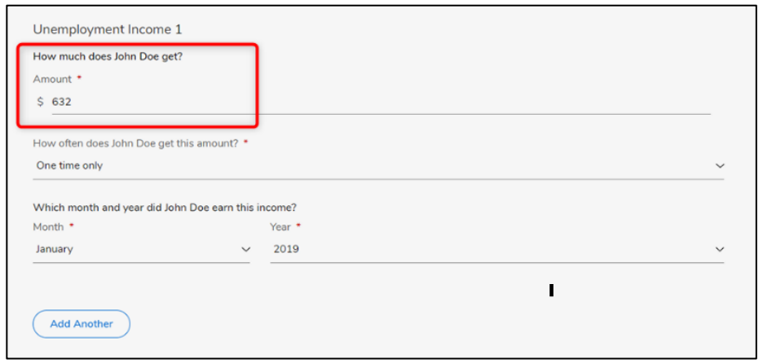
Reporting Unemployment Income
Income from Unemployment
Enter the current gross unemployment income (the amount before taxes are taken out) that should be available on the award letter or most recent unemployment stub.

Slide 36
FEMA Disaster Funding for Lost Wages Assistance (LWA) Benefit
Massachusetts was recently awarded FEMA disaster funding to provide enhanced unemployment benefits through the Lost Wages Assistance (LWA) program.
The Division of Unemployment Assistance has dispersed these funds. In summary, a $300 supplemental benefit went to eligible claimants for the weeks ending 8/1/20 through 9/5/20.
For the purpose of eligibility, these dollars are not countable for MassHealth (under 65 or over 65) eligibility. However, this supplemental benefit amount is countable when determining projected income for the Health Connector.

Slide 37
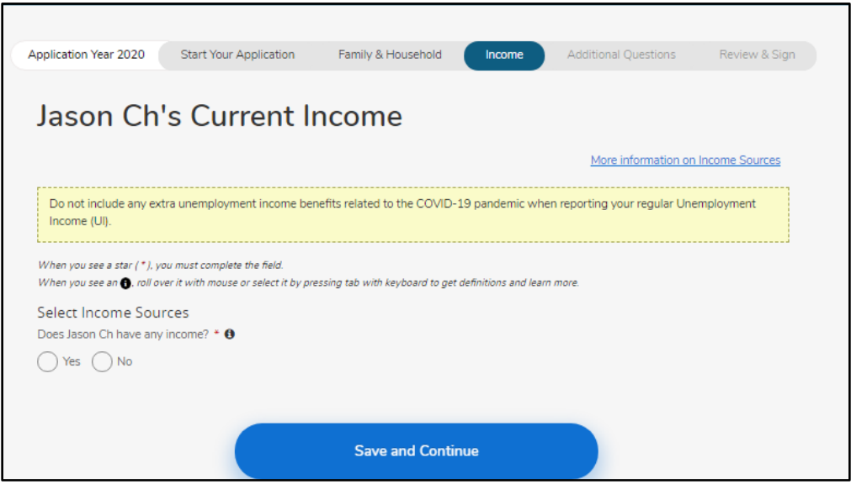
Reporting Current Income
If someone received the extra $300 supplemental LWA benefit or the $600 FPUC amount per week, DO NOT include these extra amounts when entering current unemployment income when applying or updating an application.

Slide 38
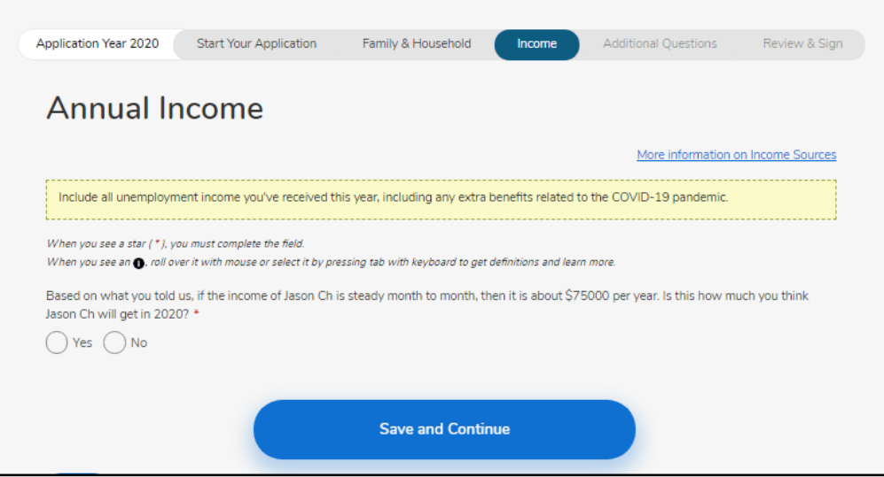
Reporting Annual Income
(slide 1 of 2)
DO include the extra $300 supplemental LWA benefit and the $600 FPUC amount per week as a part of the total expected annual income for 2020 here.

Slide 39
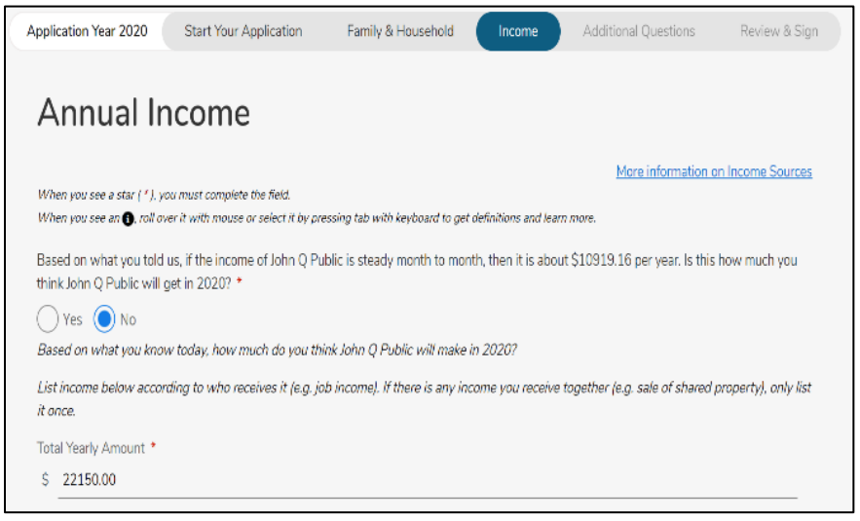
Reporting Annual Income
(slide 2 of 2)
Annual Income Include:
Money already earned this year
All the unemployment income someone expects for the remainder of 2020, including the $600 per week FPUC through July 25. As well as the $300 LWA benefit for the weeks ending 8/1/20 through 9/5/20
Any other income the member anticipates receiving later this year

Slide 40
Key Takeaways
Type of Income | Include in Current Income? | Include in Projected Annual Income?
Unemployment extension to up to 39 weeks of benefits | Yes, regular unemployment should be reported as long as it is received. | Yes, make your best prediction about your yearly income accounting for how long you expect to receive unemployment.
$600 unemployment “bump” (Federal Pandemic Unemployment Compensation) | No, do not include this amount in the unemployment benefits you report. | Yes! Do add the $600 per week in when reporting expected yearly income. Someone on unemployment from early April through July 25 will earn about $10,000 from this bump.
One-time “recovery rebate” or “stimulus payment” of $1,200 per adult and $500 per qualifying child | No, do not include this income. | No, do not include this income.
$300 supplemental Lost Wages Assistance (LWA) FEMA disaster funding benefit | No, do not include this amount in the unemployment benefits you report. | Yes! Do add the $300 per week in for the weeks of 8/1-9/5 when reporting expected yearly income.

Slide 41
Reminders (slide 1 of 2)
During the COVID-19 national emergency period, MassHealth is reminding members to respond to mail they receive from MassHealth, such as Request for Information (RFI) and Renewal forms, as soon as possible. This will ensure MassHealth has the latest information on file and that applicants and members are getting the best benefit they are eligible for.

Slide 42




Reminders (slide 2 of 2)
Members are reminded to submit changes in circumstance to MassHealth within 10 days of the change by:
 | MAhealthconnector.org: For individuals under 65, account holders, can submit a change using the Report a Change option.
 | Health Insurance Processing Center P.O. Box 4405 Taunton, MA 02780
 | FAX: 1-857-323-8300
 | PHONE: 1-800-841-2900 (TTY: 1-800-497-4648) Monday-Friday 8:00 am - 5:00 pm

Slide 43
Scenario
James was furloughed 2 days a week from his job starting on April 4th. Then, his company laid him off in August and he lost access to his health insurance. He applied for unemployment benefits and also received the “recovery rebate” and the FEMA disaster fund. At the end of August, he applied for health care coverage through MAhealthconnector.org.

Slide 44
Notice of Birth (NOB) Update

Slide 45
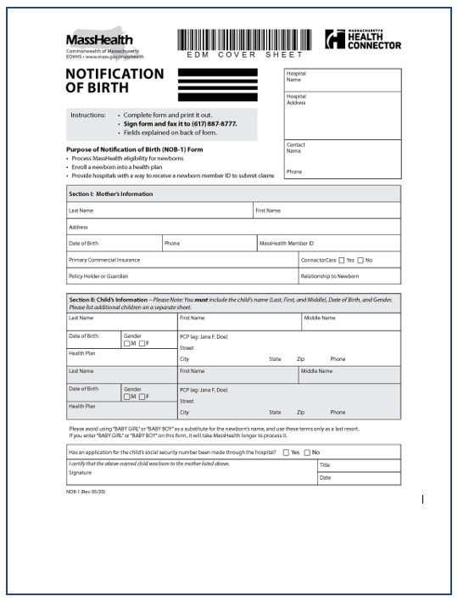
Notice of Birth Form (slide 1 of 2)
Coming January 1, 2021!
MassHealth’s Notice of Birth (NOB) form will now include fields for MassHealth health plan and PCP voluntary selection.
Assignment of all newborns to Fee for Service (FFS) when a voluntary managed care plan selection is not made on the NOB.
In cases where the family has not made a health plan selection on the NOB form:
The newborn will be placed into FFS coverage for 14-days once MassHealth eligibility has been established.
The family can voluntarily enroll the newborn in a plan sooner than 14-days by visiting MassHealthchoices.com or calling MassHealth Customer Services.
45

Slide 46
Notice of Birth Form (slide 2 of 2)
Assignment of all newborns to Fee for Service (FFS) when a voluntary managed care plan selection is not made on the NOB.
In cases where the family has not made a health plan selection on the NOB form:
If the family does not voluntarily enroll the newborn in a plan after 14-days, MassHealth will automatically assign the newborn into a managed care plan as their next-youngest sibling, if present OR a health plan in their geographic area.
46

Slide 47
MassHealth Electronic Notification of Birth (MeNOB) Application
MassHealth Electronic Notification of Birth (MeNOB) Application
Hospital facilities interested in submitting NOBs electronically should contact Sam Evans at samuel.evans@mass.gov for more information.

Slide 48
IRS Economic Impact Payments for Non-Filers Update

Slide 49
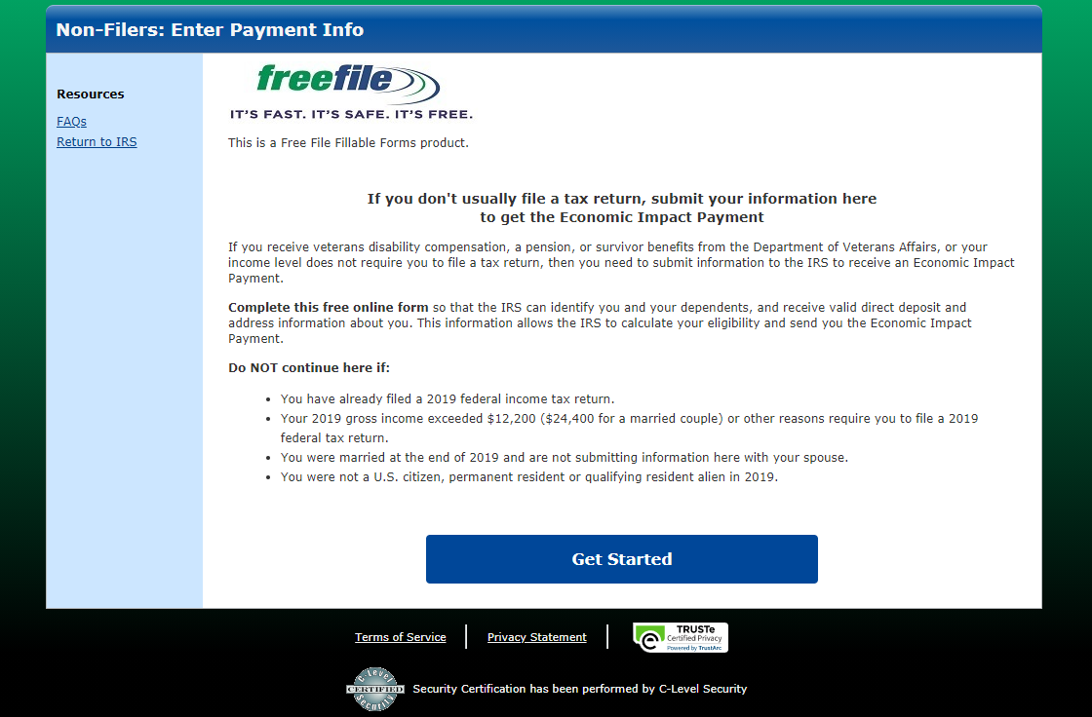
IRS Economic Impact Payments For Non-Filers Update
Low-income people and others who aren't required to file a tax return.
UPDATE: Need to register for a payment by November 21, 2020. Register by November 21, 2020 to receive payment by the end of the year.
Can easily register for a payment by using the free Non-Filers tool, available only on IRS.gov. The tool will not be available after November 21.

Slide 50
COVID-19 Resources

Slide 51
MassHealth and COVID-19:
Resource for Applicants and Members
COVID-19 and MassHealth
  Find resources and information related to the coronavirus for MassHealth applicants, members, and providers.
MassHealth: COVID-19 – Applicants and Members
  Information for members on:
    Coverage for testing and treatment for all coverage types and health plans
    Coverage for telehealth services
    Information about pharmacy
    Frequently Asked Questions

Slide 52
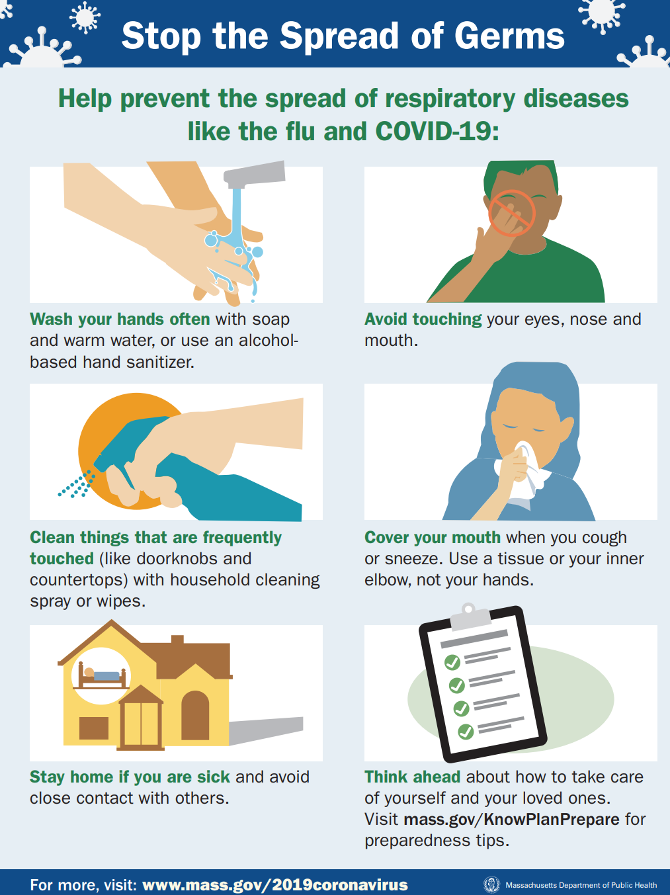
Stop the Spread
The Commonwealth is launching a strategic testing program in communities across Massachusetts that have continued to see a higher number of residents testing positive for COVID-19.
The Stop the Spread program is intended to provide low barrier, free, and easy to access testing to all Massachusetts residents.
Open to all Massachusetts residents
Testing is not restricted to residents of the cities where sites are located
You don’t need to have any symptom(s)
No cost to you
Out-of-state residents are not eligible for free testing under the Stop the Spread program

Slide 53
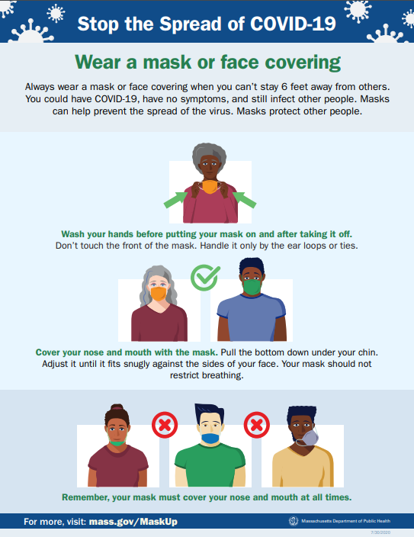
Stop the Spread Initiative
The Baker-Polito Administration announced that the state’s “Stop the Spread” initiative has extended free COVID-19 testing through October 31.
Testing is available in high priority communities across the Commonwealth. For more information and to find testing locations go to: https://www.mass.gov/info-details/stop-the-spread
For printable flyers and fact sheets: https://www.mass.gov/info-details/covid-19-printable-fact-sheets#wear-a-mask-

Slide 54
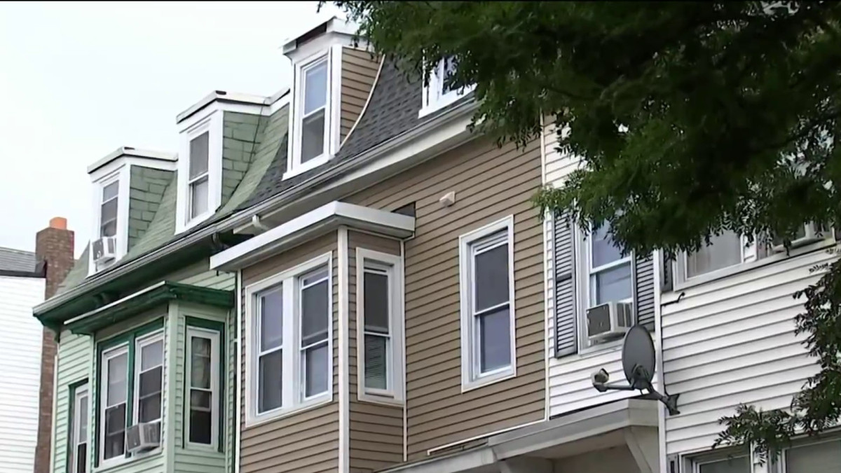
Resources for Renters, Homeowners, and Landlords
Massachusetts recently announced a new Eviction Diversion Initiative to help households as the eviction moratorium in Massachusetts expires.
There are now resources available for individuals and families struggling to make rent or mortgage payments due to COVID-19. Click here to learn more or call 2-1-1 from any phone.
You can also download and share multilingual resources that’s been created. The public information flyers are available in English, Spanish, Chinese, Haitian Creole, Khmer, Portuguese, Russian, or Vietnamese.
There is funding available NOW and the earlier households apply for aid, the quicker they will receive it.

Slide 55

Questions

