Slide 1
MassHealth Updates
Massachusetts Health Care Training Forum
July 2020

Slide 2
Agenda
MassHealth’s Response to COVID-19 Updates
ACA and SACA Application Updates – July 1, 2020
Cost Sharing Policy Updates
Medicare Savings Program (MSP) Updates
MassHealth Renewal Update
IRS Economic Impact Payments for Non-Filers
Race, Ethnicity and Language (REaL) Initiative Update
Authorized Representative Designation (ARD) and Permission to Share Information (PSI) Update
Resource
Notes:
Thank you for joining us today. There are a number of updates, the first I’ll review MassHealth’s response to COVID-19, there are a few updates since last we met which includes, Retroactive Eligibility (Up to 90 days), Changes to the HPE Extension During COVID-19 and updates to the MassHealth Student health Insurance Program premium assistance or SHIP PA Update.
Following that, we’ll review the revisions of the ACA-3 and SACA-2 paper application. The revised applications are available and changes was made effective July 1st. Also on July 1st, MassHealth updated cost sharing policies. Cost sharing is being rolled out in 2 phases, 1st phase was rolled out on July 1st. You’ll hear a lot more details of what that included.
Next, I will go over updates for the Medicare Savings Program also known as the MH Buy-In Program, followed by information about renewals for our members turning 65.
Then, we’ll review the IRS Economic Impact Payments for Non-filers, this information we ask that you share with members and clients you’re working with that are in the IRS’s non-filer group as they have additional time to receive their Economic Impact Payment, if they haven’t already.
The REaL initiative- Real stands for race, ethnicity, and language. MassHealth is dedicated to move toward greater equity in the delivery of health care for our members and across the state's health care system. In order to do this, MassHealth continues to be dedicated to improving data collection of applicants’ and members’ demographic data. We’ll review those efforts
Before we finish, you’ll hear about MassHealth applicants and members ability to complete the ARD I and PSI forms over the phone with MassHealth customer service.
And, finally, Resources for you and our members. As a result of COVID-19, one in three people in Massachusetts faces food insecurity, many for the first time. Several programs can help them and their family get the food they need to stay healthy. At the end of this presentation is information to handouts you can give members on how to access those resources.
Next slide

Slide 3
MassHealth’s Response to COVID-19 Updates
Notes:
Announced Friday the 24th, As a result of the continued COVID-19 pandemic, effective July 25th, the Secretary of Health and Human Services, Alex M. Azar extended the national public health emergency to October 24th 2020.

Slide 4
MassHealth’s Response to COVID-19 Operations Update
The MassHealth call center has maintained regular business hours, though wait times may be longer than usual at times.
In response to COVID-19, and to support the health and safety of our members and staff, all MassHealth Enrollment Centers (MECs) will be closed for walk-in visitors until the emergency is declared over.
Notes:
quick reminder that all the MECs, are still closed to walkin visitors until the COVID-19 emergency is declared over and MassHealth’s call center continues to maintain regular business hours – though wait times may be longer than usual at times.
Next slide

Slide 5
MassHealth’s Response to COVID-19 Updates (slide 1 of 3)
Maintaining MassHealth Coverage:
  MassHealth will maintain coverage for all individuals who have MassHealth (Medicaid/CHIP) coverage, Children’s Medical Security Plan (CMSP), or Health Safety Net (HSN) as of March 18, 2020, and for all individuals newly approved during the COVID-19 public health national emergency, and through the end of the month in which such national emergency period ends.
  These individuals will not lose coverage or have a decrease in benefits during this time period. Coverage will end only if an individual:
    Requests termination of eligibility
    Is no longer a resident of Massachusetts
    Is deceased
Notes:
Another reminder, that In response to the current COVID-19 public health national emergency, MassHealth implemented a number of temporary changes in eligibility-related policies and processes to support the public health efforts to expedite access to necessary health care and maintain health care coverage for both new MassHealth applicants and existing members.
So, MassHealth will maintain coverage for all individuals who have MassHealth coverage, CMSP that’s the children’s medical security plan, or HSN as of March 18th, 2020 and for all individuals newly approved during the COVID-19 public health national emergency, and through the end of the month in which such national emergency period ends. Members will not lose coverage or have a decrease in benefits during this time period. Coverage will end only if the member requested termination of eligibility, if they moved out state, or is deceased.
Next slide

Slide 6
MassHealth’s Response to COVID-19 Updates (slide 2 of 3)
For individuals who have received notices that their coverage is ending on or after March 18, 2020, no change in coverage will occur. These individuals do not have to send in paperwork to keep their coverage at this time. MassHealth will ensure their coverage does not terminate during this period.
MassHealth Eligibility Flexibilities for COVID-19
Notes:
TP: Members that received a notice letting them know their coverage was ending on or after March 18th, no change in coverage occurred. Members don’t have to send in any paperwork, However, if they are able to, we strongly encourage members to submit any outstanding verifications that have been requested – even if they requested or submitted a self-attestation for that eligibility factor.
The MassHealth eligibility flexibilities for COVID-19 is a factsheet summarizing the number of temporary changes in eligibility-related policies and processes put in place to support the public health efforts.
Next slide

Slide 7
MassHealth’s Response to COVID-19 Update (slide 3 of 3)
90 day Retroactive Eligibility for Individuals Under the Age of 65
  Individuals under the age of 65 who applied on or after March 1, 2020 can request that their coverage be retroactive up to 90 days. They may request that their eligibility start date begin as early as the first day of the third calendar month before the month of application, but no earlier than March 1, 2020.
MassHealth will not apply retroactive coverage to a member’s MassHealth ACO/MCO health plan.
Notes:
The following slides will provide summaries of the flexibilities that was put in place since last we met, in April. Individuals under the age of 65 who applied on or after March 1st can request that their coverage be retroactive up to 90-days. Individuals may request that their eligibility start date begin as early as the first day of the third calendar month before the month of application, but no earlier than March 1, 2020. Note, that retroactive coverage does not apply to a member’s MassHealth ACO or MCO health plan
Next slide.

Slide 8
HPE Extensions During COVID-19 Update
During the COVID-19 outbreak national emergency, MassHealth will accept HPE Applications for applicants 65 years of age and older, living in the community, and seeking community MassHealth benefits.
Individuals living in the community, are 65 years of age and older, may be eligible for MassHealth Standard if they meet the following requirements:
  The countable-income amount of the individual or couple is less than or equal to 100% of FPL; and
  The countable assets:
    Individual is at or equal to $2,000
    Married couple living together is at $3,000 or less
Notes:
Hospital-Determined Presumptive Eligibility (HPE) for Elders Living in the Community: In addition to individuals under the age of 65, Hospital-Determined Presumptive Eligibility (HPE) will be available to elders (ages 65 and over) living in the community. Eligibility for HPE is based on the applicant’s self-attested responses to a limited set of questions set forth in the HPE Application.
Next slide

Slide 9
Changes to HPE During COVID-19: Change to Coverage Duration
1) Individuals approved for Hospital-Determined Presumptive Eligibility (HPE) on or after March 18, 2020 and before June 30 must submit a full MassHealth application by July 31st to avoid a lapse in coverage.
  MassHealth will notify HPE members of this change.
  For example, an HPE eligible applicant whose coverage began May 15, 2020 will lose coverage if they don’t submit a full MassHealth application by July 31st. If they submit a full application by July 31, their HPE coverage will continue until MassHealth makes an eligibility determination.
Notes:
HPE Coverage duration have changed. Individuals approved for HPE on or after March 18th and before June 30th must submit a full MassHealth application by July 31sr, the end of the month, to avoid a lapse in coverage
Members have been notify of this change.
Next slide

Slide 10
HPE During COVID-19: Changes to Coverage Duration (continued)
  Individuals approved for HPE benefits on or after June 30, 2020, their HPE benefit will end under standard HPE rules.
    HPE coverage starts on the day that the qualified hospital makes the presumptive eligibility determination and ends on the last day of the month following the month that HPE was approved if a full application has not been submitted by that day; or
    If a full application has been submitted by that date, then the HPE coverage ends on the date a determination is made based on the full application.
2) An individual may have up to two HPE periods within a 12-month period.
Notes:
For individuals approved for HPE on or after June 30th, their HPE benefit will end under standard HPE rules, which is, that the HPE coverage starts on the day that the qualified hospital makes the presumptive determination and ends on the last day of the month following the month that HPE was approved, if a full application hasn’t been submitted by that day. Or if a full application has been submitted by that date, then the HPE coverage ends on the date a determination is made based on the full application.
The 2nd change to the coverage duration is that an individual may have up to 2 HPE periods within a 12 month period.
Next slide

Slide 11
SHIP PA Program Update
The Student Health Insurance Plan (SHIP) Premium Assistance (PA) Program is ending at the end of the 2019-2020 academic year. Students will receive notices about the end of the SHIP PA program so that they can begin planning for other coverage.
To ensure that students on the SHIP PA program do not lose affordable coverage during the COVID-19 public health national emergency, MassHealth will maintain their coverage through the course of their SHIP plan period and through end of the month in which the national emergency period ends.
Students with questions on current SHIP coverage or the needed transition into the new academic school year of 2020-2021 can contact the MassHealth SHIP PA customer service at (855-273-5903).
For more information about the MassHealth SHIP PA Program
Notes:
The MassHealth Student Health Insurance Plan Premium Assistance Program (SHIP PA) was for MassHealth members who were full time students at participating Massachusetts colleges and who had access to a cost-effective student health insurance plans. It was designed for full time student and if the student was determined eligible for the program, they would have enrolled in SHIP PA during their school’s annual insurance waiver process.
However, to avoid all those students from experiencing untenable premium increases, MassHealth will be ending the SHIP PA Program at the end of the 2019-2020 academic year.
As we are in the midst of the COVID-19 public health national emergency, to ensure students on the program don’t lost affordable coverage during the national emergency, MassHealth will maintain their coverage through the course of their SHIP plan period and through the end of the month in which the national emergency ends.
SHIP PA transition FAQ is available on the SHIP PA webpage at the link provided here.
Q/A
If you remain eligible for MassHealth when your SHIP plan ends, MassHealth will become your primary health insurance coverage and you will continue to have access to MassHealth benefits through a MassHealth health plan. MassHealth will mail you an Enrollment Package 10 days after your SHIP plan ends. You will be able to select a MassHealth Health Plan that works for you. Review all options carefully to ensure that the plan you choose is available in your area and offers the best provider network that suits your needs.
Can you use your MassHealth to waive your school’s SHIP requirement? If you remain eligible for MassHealth you will be able to use your MassHealth health plan as your primary insurance to waive your school’s SHIP requirement. Please note that MassHealth Limited, Health Safety Net, and the Children’s Medical Security Plan are not considered comprehensive plans, therefore cannot be used to waive your school’s SHIP requirement.
Options if you are no longer eligible for MassHealth? • You may be able to purchase the SHIP plan offered by your school. • You may be able to purchase a health insurance plan through the Massachusetts Health Connector. Go to MAHealthConnector.org or call 1-877-MA-ENROLL (1-877-623-6765) to learn more. It may take you several weeks to complete the enrollment process, so begin your search now.

Slide 12
ACA-3 & SACA-2 Application Updates: July 1, 2020

Slide 13
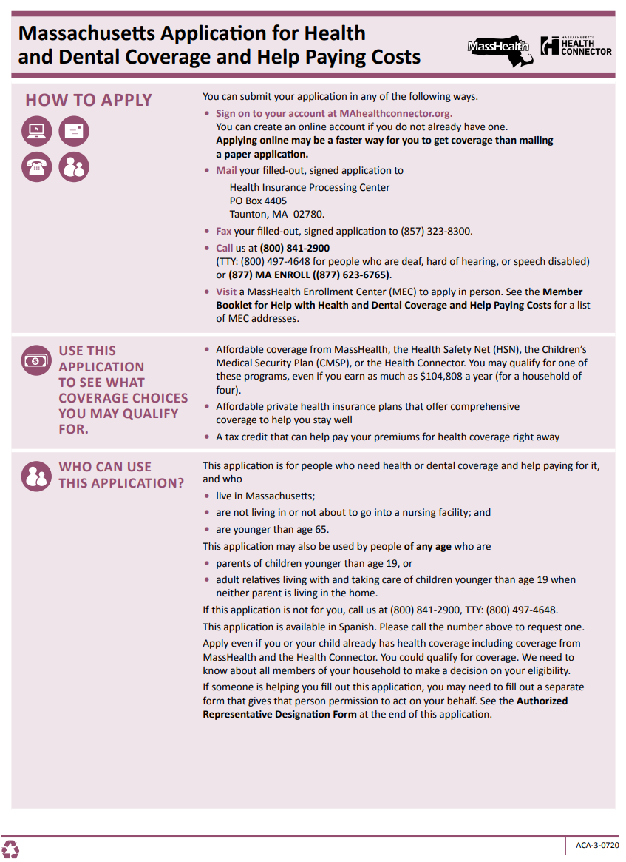

ACA-3 Application Revisions:
July 1, 2020
ACA-3 Application Revisions for
July 1, 2020 includes:
  Added language about race and ethnicity
  to explain use of data
  Moving the Incarceration question to Step 1
  Person 1. It was removed from Other
  sections—persons 2 through 4
  Updated language in the sections
  “Other income” and “Alimony” to reflect
  the current tax law
  Addition of COVID-19 information and resource
  New step 5 to capture information about Health Reimbursement Accounts
  Aligned language for Supplement A: Health Insurance from Jobs (question 16) to ensure consistency with the online application
Notes:
The Massachusetts Application for Health and Dental Coverage and Help Paying Costs or commonly known as the ACA-3 was recently revised on July 1st. It is available for download or to print from the MassHealth website. The following are high levels of the changes that were made:
New language was added explaining how race and ethnicity data will be used. You will hear a little more about this in a bit.
Next: the incarceration question was removed from other sections to Step 1 Person 1.
Language was updates in the Other Income and alimony section to reflect current tax law.
On the 2nd page of the instructions section, you will notice a new web url. The website Points folks resources and information related to COVID-19 for MassHealth applicants, and members.
The next change is the addition of a new step 5 which will capture info about HRAs or the Health Reimbursement Agreement which impacts Qualified Health Plan (QHP) and Advanced Premium Tax Credit (APTC) eligibility.
And lastly we aligned languages for Supplement A to the online application.
--------------
“If you are receiving alimony payments from a divorce, separation agreement, or court order that was finalized before January 1, 2019, enter the amount of those payments.”
You do not need to tell us about the following types of income:
Alimony payments from a separation or divorce finalized on or after January 1, 2019
The BBA (Bipartisan Budget Act) rules eliminated the deduction of qualified postsecondary education expenses. Tuition and fees paid are no longer used as a deduction.
IRS Form 1040A is no more relevant post tax year 2018. HIX will update the language to indicate where to find the correct line and amount displayed in the current tax form 1040 or 1040-SR.
This question is also updated in the Online application

Slide 14
How to Apply: ACA-3
Applicants can use any of the options below:
  Online at MAhealthconnector.org – FASTEST
  Phone: 1-800-841-2900 (TTY: 1-800-497-4648)
        Monday-Friday 8:00 am - 5:00 pm
  Mail the completed, signed application to:
        Health Insurance Processing Center
        P.O. Box 4405
        Taunton, MA 02780
  Fax to (857) 323-8300
  Enrollment Assisters: Call ahead and make an appointment
Printable and downloadable, new member booklet for Health and Dental Coverage and Help Paying Costs (ACA-1) and the ACA-3
Notes:
For MA residents and individuals under the age of 65, or those that are caretaker relatives of children younger than 19, they can go to mahealthconnector.org to complete the application online, as this is the fastest way to submit this application.
Individuals can call MassHealth customer service and complete an application over the phone or seek enrollment assisters to help with their application. Individuals should call first and make an appointment as many assisters are currently working remotely

Slide 15
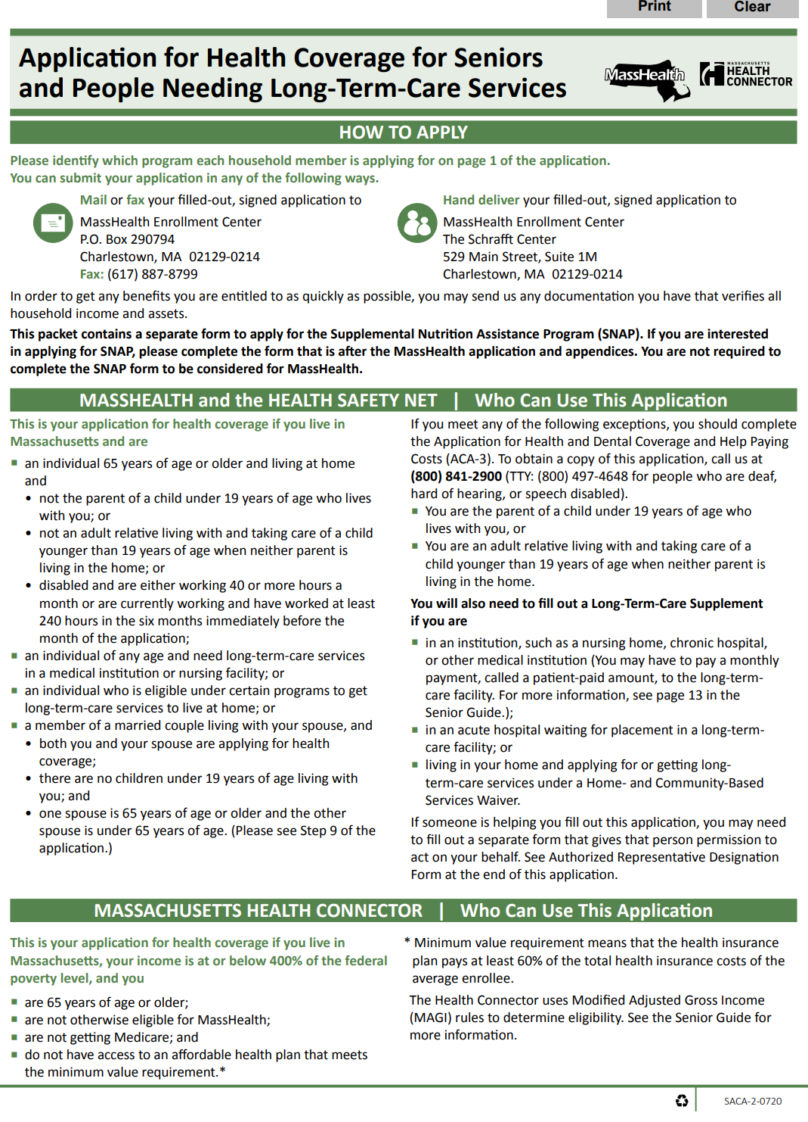

SACA-2 Application Revisions: July 1, 2020
SACA-2 Application: Revisions for July 1, 2020 includes:
  New language explaining how race and ethnicity data will be used
  Updated language in the sections “Other income” and “Alimony” to reflect current tax law
  New Section 7 to capture information about Health Reimbursement Accounts
  Addition of COVID-19 information and resource
  Aligned language for Supplement D: Health Insurance (question 16) to ensure consistency with the online application.
Notes:
I’m not going to review the SACA2 revisions as revisions made to the application is the same revisions that was made in the ACA-3 application. I do want to point out the addition of language explaining how MassHealth will use race and ethnicity information and the new Section 7 that captures the HRA information.

Slide 16
How to Apply: SACA-2
Applicants can use any of the options below:
  Mail the completed, signed application to:
        MassHealth Enrollment Center
        P.O. Box 290794
        Charlestown, MA 02129-0214
  Fax to (617) 887-8799
  Enrollment Assisters: Call ahead and make an appointment
The new Senior Guide to Health Care Coverage (SACA-1) member booklet and the fillable PDF of the SACA-2 application can be viewed and printed.

Slide 17
Supplies and Use of Earlier Versions
Supplies and Use of Earlier Versions of the ACA-3 and SACA-2:
  Current supplies can be used until August 1, 2020.
Recycle the March 2020 version once supplies of the July 2020 version of the ACA-3 and SACA-2 arrives.
Although the March 2020 version will be accepted until August 1, 2020, do not distribute to the public once the new version has been received.

Slide 18
To Request Supplies
To order paper applications
  Call: 1-800-841-2900
  Fax a request: 617-988-8973
  Email a request: publications@mahealth.net
When ordering be sure to include:
  Name of the form being ordered (e.g., ACA-3, SACA-2)
  Quantity requested
  Name of the person, organization, and shipping address
  A direct phone number in case there is a question about the order
Notes:
Here is how you can order supplies of MassHealth’s materials such as the member booklet and application.

Slide 19
Cost sharing policy updates
Notes:
Polling question:
Did you attend the Understanding MassHealth’s Cost Sharing Policy Update presentation?
Yes
No
If No, have you reviewed the Understanding MassHealth’s Cost Sharing Policy Update presentation?
Yes
No

Slide 20
Cost Sharing Policy Updates
MassHealth is updating their cost sharing policy in order to come into compliance with the rules set forth in the Affordable Care Act. (See SSA §§ 1916 & 1916A; 42 C.F.R. Parts 447 and 457).
How are Copays Capped?
BEFORE 07/01/2020
PHASE 1 (07/01/20)
PHASE 2 (01/01/21)
  Annual pharmacy and acute inpatient hospital copay caps.
  Annual copay caps on drugs dispensed by the pharmacy.
  Monthly copay caps on drugs dispensed by the pharmacy.
      $250 per calendar year on drugs dispensed by pharmacies.
      $250 per calendar year on drugs dispensed by pharmacies. New member exclusions will apply.
      Members will be assigned a copay cap not to exceed 2% of family income.
      $36 per calendar year on non-behavioral health acute inpatient hospital stays.
      Please note, acute inpatient hospital copays have been eliminated as of 03/18/20.
      Please note, acute inpatient hospital copays have been eliminated as of 03/18/20.
ACA rules require that states limit cost sharing to no more than 5% of each individual’s family income.
Notes:
MassHealth is updating the cost sharing policy in order to come into compliance with the rules in the ACA. Cost sharing is defined as the dollar amount eligible members pay when they get certain health care services. For MassHealth, cost sharing includes premiums and copays. MAssHealth will implement cost sharing in 2 phases, phase 1 which is also known as partial implementation, happened on July 1st and phase 2, which is also known full implementation will be implemented on 1/1/ of 2021.
Here is a summary of each phase of implementation as well as compares it to what cost sharing was before July 1st. So let’s walk through the different columns.
copay caps, copay caps is the maximum dollar amount of copays that a member can be charged in a given time period.
how are copays capped? The first column, Pre phase 1, the annual cap was at $250 per calendar year for drugs and $36 for non-behavioral health acute inpatient hospital stays.
Moving to the second column, which is phase 1 – members still have an annual copay cap of $250 for drugs dispensed by pharmacies. What’s new here, is that All members at or below 50% FPL and referred eligible will have their copays eliminated. What’s also changed here, is the elimination of acute inpt hospital copays. This is a permanent elimination of copays for inpt hospitals.
Moving to the last column, phase 2, which will be rolled out on 1/1/of 2021, MassHealth will start tracking copays on a monthly basis for drugs dispensed by pharmacies. MassHealth Members will be assigned a copay cap, which will not exceed 2% of the family income.

Slide 21
How Will Cost Sharing be Rolled Out?
IMPLEMENTATION OVERVIEW TWO PHASES
Cost sharing changes will be implemented in two phases: 1) partial implementation and 2) full implementation.
Phase 1 (Partial implementation)
Date: July 1, 2020
Policy Overview:
  Pharmacy Copays for members with incomes at or below 50% FPL and for members categorically eligible for MassHealth because they are receiving other public assistance (“referred eligibles”) will be eliminated.
  Copays for FDA-approved medications for detoxification and maintenance treatment of substance use disorders (SUD), preventive services rated Grade A & B by the US Preventive Services Task Force (USPSTF) or broader exclusion specified by MassHealth, and vaccines and their administration recommended by the Advisory Committee on Immunization Practices (ACIP) will be eliminated for all members.
  Please note that acute inpatient hospital copays have been eliminated for all members effective 03/18/20.
Notes:
here you have a detailed look at each phase of implementation. For phase 1, Basically we’re eliminating copays for members with incomes at or below 50% FPL and for members who are referred eligible which are those members who are categorically eligible for MassHealth because they are receiving other public assistance, like, SSI benefits or TAFDC cash assistance. And, copays will be eliminated for all members accessing FDA approved medications for detox and maintenance treatment for substance use disorder, preventive services rated by the USPSTF, and vaccines recommended by ACIP will be eliminated for all members.
STOP
Cost sharing will eliminate copays for nearly 60% of MassHealth’s population on July 1.
Definition: Referred Eligibles: Members who are categorically eligible for MassHealth because they are receiving other public assistance (e.g. receiving Supplemental Security Income (SSI) benefits or receiving Transitional Aid to Families with Dependent Children (TAFDC) cash assistance).

Slide 22
How Will Cost Sharing be Rolled Out? (continued)
IMPLEMENTATION OVERVIEW TWO PHASES
Cost sharing changes will be implemented in two phases: 1) partial implementation and 2) full implementation.
Phase 2 (Full Implementation)
Date: January 1, 2021
Policy Overview:
  Pharmacy copay caps will change from the current $250 annual cap to a member-specific, monthly copay cap.
  Pharmacy copays caps will not exceed 2% of income for non-exempt adult members. They will be calculated at the individual level and will be based on a member’s FPL and household size.
  Members will receive notices every time there is a change to their copay cap amount and/or when they meet their copay cap for the month.
  Please note that changes that took effect on 7/1/20 as part of the partial implementation will continue.
Notes:
Here in phase 2 or when the policy is fully implemented, which will be Jan. 1st . MassHealth will change from an annual copay structure to a monthly structure and members will be assigned a copay cap, which will not exceed 2% of the family income. What’s also new here is that members will receive a notice every time there is a change to their copay cap amount and or when they’ve met their cap for the month.

Slide 23
What is Changing July 1, 2020?
WHAT IS CHANGING?
WHAT IS STAYING THE SAME?
At the end of each month, MassHealth will identify members with incomes at or under 50% FPL and referred eligibles and exclude them from copays for the following month. Even if a member's income changes during the month, their exclusion will remain in place until MassHealth identifies the members again at the end of the month.
Copays for FDA-approved medications for maintenance and treatment of substance use disorders (SUD), preventive services rated Grade A & B by the US Preventive Services Task Force (USPSTF) or broader exclusion specified by MassHealth, and approved vaccines and their administration recommended by the Advisory Committee on Immunization Practices (ACIP), will be eliminated for all members.
Acute inpatient hospital copays have been eliminated for all members effective 03/18/20.
All current copay exclusions (e.g. pregnancy, Native American status, etc.) will remain in place.
Copays will not be assessed for members enrolled in One Care, Senior Care Options (SCO), or Program of All-Inclusive Care for the Elderly (PACE).
There will be no changes to the claims submission process for providers.
The annual $250 pharmacy copay cap for non-exempt members will remain in place until 01/01/2021.
Notes:
this slide gives you in greater detail of what’s changing and what will stay the same for phase 1 of implementation.
Here’s an overview of what’s changed and what’s staying the same.
What’s not changing are all current copay exclusions, copays will not be assessed for members enrolled in One Care, SCO, or PACE.
There’s no change to how providers submit claims. And, for non-exempt members, they still have an annual pharmacy copay cap of $250, which will remain in place until full implementation.
- Only if questions come up from ACO providers: The annual $250 pharmacy copay cap for non-exempt members will remain in place until 01/01/2021. This information will continue to be exchanged via the 834.

Slide 24
Who is Not Subject to Cost Sharing?
(slide 1 of 3)
Populations and services currently excluded from copays remain excluded, including additions as noted (see 130 CMR 450.130, 506.015 and 520.037):
MEMBERS
Excluded Populations from Cost Sharing (Copays):
NEW: Members with incomes at or below 50% FPL
NEW: Members categorically eligible for MassHealth because they are receiving other public assistance (“referred eligible”) such as Supplemental Security Income (SSI), Transitional Aid to Families with Dependent Children (TAFDC), or services through the Emergency Aid to the Elderly, Disabled and Children (EAEDC) Program
Members under the age of 21 years old
Pregnant women or those in the post-partum period
Notes:
Slides 24 and 25 are the list of members excluded from copays. Here we are adding to the list to include those members with incomes at or below 50% FPL and the referred eligible.

Slide 25
Who is Not Subject to Cost Sharing?
(slide 2 of 3)
MEMBERS
MassHealth Limited members
MassHealth Senior Buy‑In members or MassHealth Standard members for drugs covered under Medicare Parts A and B only, when provided by a Medicare-certified provider
Members in a long-term care facility
Members receiving hospice services
Members who are former foster care individuals eligible for MassHealth Standard, until the age of 21 or 26 as specified by 130 CMR 505.002(H)
Members who are American Indians or Alaska Natives
Members who have reached their pharmacy cost sharing cap

Slide 26
Who is Not Subject to Cost Sharing?
(slide 3 of 3)
Populations and services currently excluded from copays remain excluded, including additions as noted (see 130 CMR 450.130, 506.015 and 520.037):
SERVICES
Excluded Services from Cost Sharing (Copays) include:
NEW: Copays for FDA-approved medications for detoxification and maintenance treatment of substance use disorders (SUD)
NEW: Preventive services rated Grade A & B by the US Preventive Services Task Force (USPSTF) or broader exclusion specified by MassHealth, and vaccines and their administration recommended by the Advisory Committee on Immunization Practices (ACIP)
NEW: Acute inpatient hospital stays
Emergency services
Family planning services and supplies
Smoking cessation products and drugs
Provider-preventable services
Notes:
Again here, we’re adding to the list of services excluded from copays. Those services that have been on this list will remain excluded like emergency services

Slide 27
What Are the Services Excluded from Copays?
POLICY OVERVIEW: PARTIAL IMPLEMENTATION
July 1, 2020: Copays for FDA-approved medications for detoxification and maintenance treatment of substance use disorders (SUD), preventive services rated Grade A and B by the U.S. Preventive Services Task Force (USPSTF) or broader exclusion specified by MassHealth, and all approved vaccines and their administration recommended by the Advisory Committee on Immunization Practices (ACIP) will be eliminated for all members.
Drug Categories Impacted:
  Low-dose Aspirin
  Breast cancer prevention and treatment medication
  Colonoscopy preparations
  Folic acid supplementation
  HIV prevention and treatment medication
  Statins
  Substance Use Disorder (SUD) treatment and maintenance using Federal Drug Administration (FDA)-approved medications
  ACIP approved vaccines
Notes:
this is a summary of the drug categories that are in the exclusion list. An appendix listing Drugs and Vaccines Excluded from Copays is available at the end of the Understanding MassHealth Cost Sharing Policy Updates presentation. That presentation is still available on the MTF website-under Learning Series, if you have not had a chance to review it or would like the full list of populations and services excluded from copays starting on July 1, 2020. Note, the excluded drugs and vaccines list is subject to change. Members with questions related to the drugs and vaccines excluded from copays should reach out to their health plan, either their ACO plan or MCO plan or MassHealth for the latest information.

Slide 28

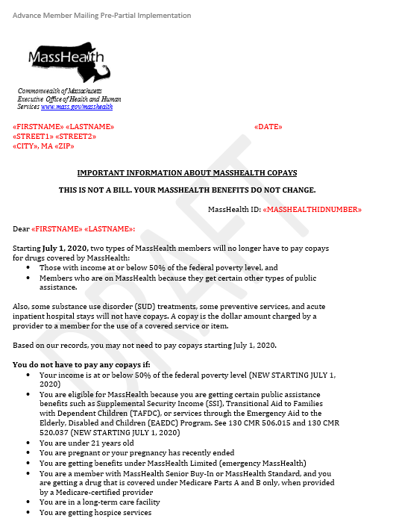
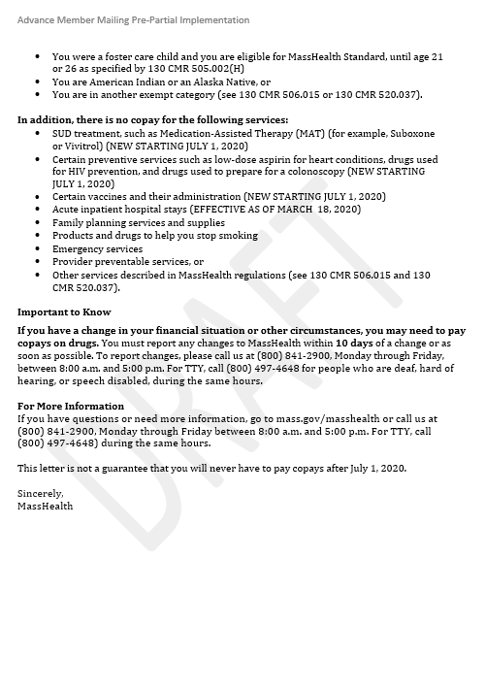
How Will Members Be Notified?
Members will be notified by mail of the changes to their MassHealth copay obligation.
  Advance Member Mailing:
  Notice notifies newly exempt members (i.e. those at or under 50% FPL and “referred eligibles”) of the change to copay policies.
  The notice was mailed out the beginning of May 27th.
Notes:
Member notices, here’s an example of the letter members who’ll be newly excluded from copays will receive. It will let them know they no longer have to pay copays for covered drugs.
I want to quickly point out, at the top of the letter, and if members ask you, let them know this letter is not a bill from MassHealth, it is informational only and their benefits didn’t change.

Slide 29
How Will Members Be Notified?
(continued)
New members will be notified of the changes to their MassHealth copay obligation through an insert sent with the approval notice.
  Notice Insert:
  Notifies new MassHealth members of the updated copay policies.
  Member’s will receive notices upon being deemed eligible for MassHealth.
Notes:
(note) Add Polling Questions after this slide
Effective July 1, 2020, those excluded from pharmacy copays are?
A- MassHealth members over the age of 65
B- MassHealth members that are at or below 50% FPL
C- MassHealth members that are also known as “referred eligible”
D- MassHealth members that are at or below 100% FPL
E- Both B and C
F- Both A and D
G – None of the Above

Slide 30
Medicare Savings Program (MSP) Updates

Slide 31
Medicare Savings Program (MSP)
The Medicare Savings Program (MSP), also known as the MassHealth Buy-In Program, can help older Massachusetts residents and residents living with a disability save on their Medicare coverage. The MassHealth Buy-In Program includes:
  Qualified Medicare Beneficiary (QMB) program
  Buy-In Specified Low-Income Medicare Beneficiary (SLMB)
  Qualifying Individuals (QI) program
On January 1, 2020, eligibility for these programs expanded.
Notes:
Medicare Savings Programs are federally funded programs administered by each individual state. These programs are for people with limited income and resources and help them pay for some or all of their Medicare premiums, deductibles, copayments and coinsurance.
In Massachusetts, this program is the “MassHealth Buy In” Programs. As part of the Medicare Savings Programs, Massachusetts offers three different coverage types.
MassHealth Senior Buy-In for Qualified Medicare Beneficiary (QMB)
The MassHealth Buy-In for Specified Low-Income Medicare Beneficiaries (SLMB)
The MassHealth Buy-In for Qualifying Individuals (QI)
On Jan. 1st, phase 1 of the MSP expansion was implemented which increased the income and assets and resource limits for these programs.

Slide 32
Medicare Savings Program (MSP): Income and Asset Limits
Senior Buy-In Qualified Medicare Beneficiary (QMB) Expansion
You are | Income is at or below | Asset/resources at or below
An individual | $1,383 per month | $15,720
A married couple living together | $1,868 per month | $23,600
Notes:
QMB, before the Eligibility Expansion, the Income limit was below or equal to 100% of FPL. The expansion increased the Income limits to below or equal to 130% of FPL. Which translates to, for an individual, it’s an income at or below $1,383/month or an asset and resource limits for an individual at $15,720 and $23,600 for a married couple living together.

Slide 33
Medicare Savings Program (MSP): Income and Asset Limits (cont.)
Buy-In Specified Low-Income Medicare Beneficiary (SLMB) and Qualifying Individuals (QI) Expansion
You are | Income is at or below | Asset/resources at or below
An individual | $1,755 per month | $15,720
A married couple living together | $2,371 per month | $23,600
Notes:
Before the expansion, SLMB and QI’s Income limit was below or equal to 135% of the Federal Poverty Level (FPL). When it was expanded, the new Income is now below or equal to 165% of the Federal Poverty Level (FPL). So, for an individual, that’s income at or below $1,755/month or $2,371/month for a married couple living together. As for assets and resource limits its not at or below $15,720 for an individual and $23,600 for a married couple living together, which is the same asset and resource limits as QMB.

Slide 34
Medicare Savings Program (MSP) Update
Correcting a system error:
  Due to a system error in calculating eligibility, some members who should have been approved for the Qualified Medicare Beneficiary (QMB) program were not. The error has been corrected.
  As a result, members who should have been approved for QMB will receive a notice and be upgraded as follows:
Members who… | Will be upgraded to QMB with a retroactive start date…
Were receiving SLMB or QI before January 1, 2020 | Of January 1, 2020.
Became eligible for QMB but were receiving SLMB or QI on or after January 1, 2020 | Based on the eligibility start date of their original MassHealth Buy-In Program.
Notes:
It was discovered that some members who should have been approved for QMB were not due to a systems error in calculating eligibility. The error has been cored and members who should have been approved for QMB received notices and was upgraded as follows.
Read-

Slide 35
Masshealth renewal

Slide 36
MassHealth Renewal for Individuals Turning 65
MassHealth will be sending members turning 65 a renewal package
The head of household (HOH) will be sent a SACA-2 form and have 45 days to respond
  Households will be able to respond by mail, or fax
  If the household responds, eligibility will be based on the application data and generate appropriate request for information (RFI), if applicable
  If the household fails to respond, MassHealth will maintain the members’ current coverage during the COVID-19 public health national emergency, and through the end of the month in which such national emergency period ends
  These individuals will not lose coverage or have a decrease in benefits during this time period

Slide 37
MassHealth Renewal for Individuals Turning 65 (cont.)
We encourage members to respond to MassHealth’s mailings in order to keep their eligibility determinations up to date
The transitioning of the over 65 population is important to ensure that:
  Buy-In benefits can be given if eligibility criteria is met
  Prevent age specific claim issues

Slide 38
IRS Economic Impact Payments for non-filers

Slide 39
Who is Eligible for the Economic Impact Payment?
Economic Impact Payments (Payments) authorized by the Coronavirus Aid, Relief, and Economic Security Act (CARES Act)
  Usually, married couples qualify to receive a $2,400 payment while others normally qualify to get $1,200.
  People with qualifying children under 17 can get up to an additional $500 for each child.
Who is eligible for the Economic Impact Payment?
  U.S. citizens, permanent residents and qualifying resident aliens who:
    Have a valid Social Security number
  Could not be claimed as a dependent of another taxpayer, and
  Had adjusted gross income under certain limits.
Notes:
The Economic Impact Payments provided, for married couples – they were qualified to receive $2,400, while an individual normally qualified for $1,200. The amount increased depending on the number of dependents was in the family.
Those eligible for the Economic Impact Payments included those that are have US citizenship, are permanent residents and qualifying resident alien, they can’t be claimed as a dependent and had adjusted grow income under certain limits.
----------------------
Who will receive the Economic Impact Payment automatically without taking additional steps?
Most eligible U.S. taxpayers will automatically receive their Economic Impact Payments including:
Individuals who filed a federal income tax for 2018 or 2019
Those receiving Social Security retirement, disability (SSDI), survivor benefits
Supplemental Security Income (SSI) recipients
Recipients of Veterans Affairs Compensation and Pension (C&P) benefits
Individuals who receive Railroad Retirement (RRB) benefits

Slide 40
IRS Economic Impact Payments For Non-Filers (continued)
IRS Non-Filers:
  Low-income people and others who aren't required to file a tax return.
  Need to register for a payment by October 15. Register by October 15 to receive payment by the end of the year.
  Can easily register for a payment by using the free Non-Filers tool, available only on IRS.gov.
Who should use Non-Filers to receive the Economic Impact Payment?
  You are not required to file a federal income tax return for 2019 for any reason including:
    Your income is less than $12,200
    You’re married filing jointly and together your income is less than $24,400
    You have no income
Notes:
Low-income people and others who aren't required to file a tax return may be eligible for the Economic Impact Payment, if they haven’t received it, and they can easily register for a payment by using the free Non-Filers tool, available only on IRS.gov. Individuals will need to register by Oc. 15th for a payment.
The IRS defines Non-filers as those who aren’t required to file a federal income tax return for any reasons, including if their income is less that $12,200 for an individual, and $24,400 for a married couple filing jointly, or if the individual doesn’t have income.

Slide 41
IRS Economic Impact Payments for Non-Filers: Non-Filers Tool
Designed for people with incomes typically below $24,400 for married couples, and $12,200 for singles.
  This includes couples and individuals who are homeless.
People can qualify, even if they do not have earned income or work.
The Non-Filers tool is not a tool for individuals that have already filed either a 2018 or 2019 return.
For more information: IRS Economic Impact Payment Information Center
Notes:
The non-filer tools should be used for those couples and individuals who are homeless.
However, the non-filers tool is not a tool for individuals that have already riled either their 2018 or 2019 return.

Slide 42
Race, Ethnicity and Language (REaL) Initiative Update

Slide 43
Race, Ethnicity and Language (REaL) Initiative
MassHealth continues to be dedicated to improving data collection including demographic data.
Data collection helps MassHealth make informed policy and operational decisions to provide equitable access to health coverage for members and tailor services to meet members’ needs.
Notes:
As the Commonwealth's Medicaid program and source of coverage for over one-quarter of the Commonwealth's population, MassHealth is dedicated to move toward greater equity in the delivery of health care for our members and across the state's health care system. In order to do this, MassHealth continues to be dedicated to improving data collection of applicants’ and members’ demographic data. MassHealth formed a workgroup that is focused on improving the data collection of demographic data to help MassHealth monitor and evaluate the delivery of our services, improve access to MassHealth coverage and services across the Commonwealth, and tailor services to meet member’s needs.
As you heard me mention earlier for our MassHealth ACA and SACA application updates, related to this is the New language explaining how race and ethnicity data will be used

Slide 44
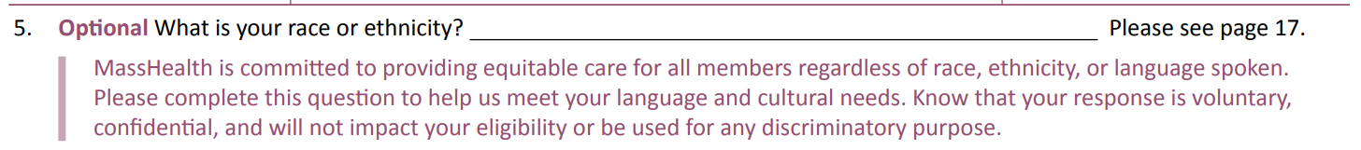
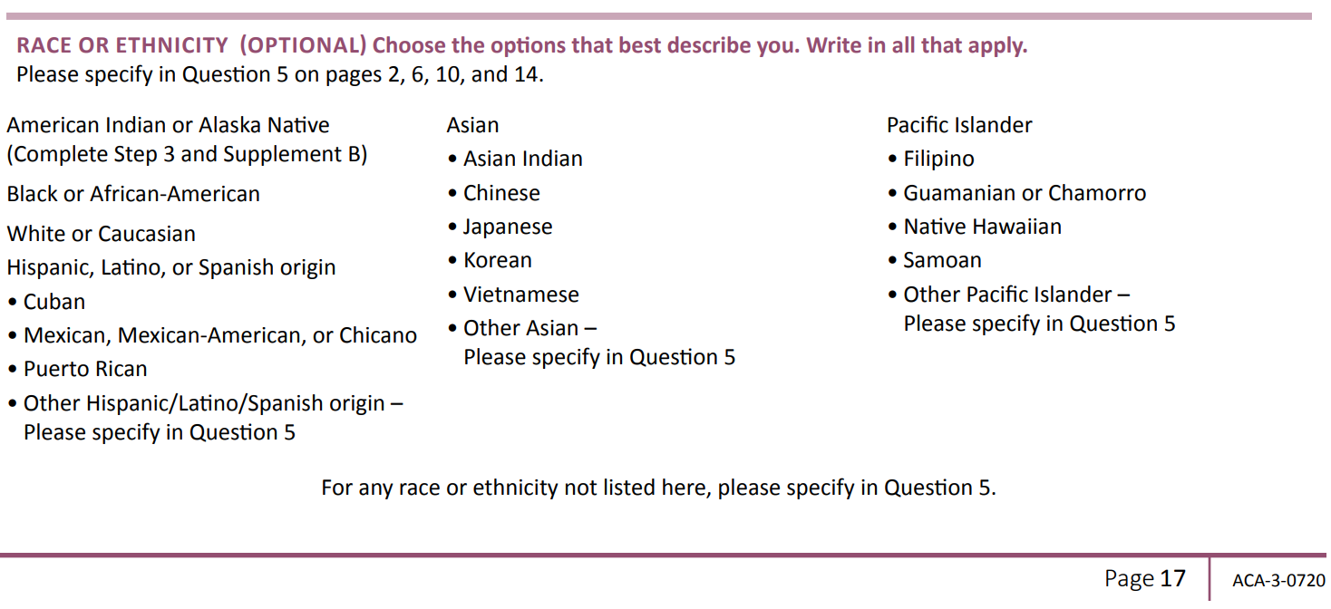
Race, Ethnicity and Language (REaL) Initiative (continued)
Question is optional
Notes:
Here’s the question in both of the MassHealth applications for which this effort relates to.

Slide 45
Authorized Representative Designee (ARD I) and
Permission to Share Information (PSI) Update

Slide 46
MassHealth Now Accepts ARD I and PSI Form Completion Verbally
Effective 06/29/2020, MassHealth applicants or members may complete the ARD I (Authorized Representative Designee) and PSI (Permission to Share Information) forms verbally on a recorded phone line with MassHealth Customer Service.
IMPORTANT: Both the MassHealth applicant or member and Assister or designee must be on the phone at the time of request.
Note:
  The ability to provide a Verbal ARD I will continue beyond the COVID-19 national emergency period.
  The ability to provide a Verbal PSI will be reviewed when the COVID-19 national emergency period ends.

Slide 47
MassHealth Now Accepts ARD I and
PSI Form Completion Verbally (continued)
Verbal requests for all ARD II or ARD III designations will not be completed over the phone.
  Continue to complete and submit by mail or fax requests for ARD II and ARD III.
  Mail to: Health Insurance Processing Center
        P. O. Box 4405
        Taunton, MA 02780
  Or Fax the signed and completed form to 1-857-323-8300
The ARD forms are available online on the MassHealth website here

Slide 48
resource

Slide 49
MassHealth and COVID-19:
Resource for Applicants and Members
COVID-19 and MassHealth
  Find resources and information related to the coronavirus for MassHealth applicants, members, and providers.
MassHealth: COVID-19 – Applicants and Members
  Information for members on:
    Coverage for testing and treatment for all coverage types and health plans
    Coverage for telehealth services
    Information about pharmacy
    Frequently Asked Questions

Slide 50
Food Assistance Resources for MassHealth Members
Food assistance handouts:
  For members-facing food assistance the handout provides information about available resources.
  The handout can be printed and given to members, or if your staff are connecting with members via phone, text, or email, they can provide members the web address for this handout at:
  English version: https://www.mass.gov/doc/food-assistance-during-the-covid-19-emergency/download
  Spanish version: https://www.mass.gov/doc/asistencia-alimentaria-durante-la-emergencia-por-covid-19/download
  You can find accessible versions for this handout here (English) and here (Spanish)
Notes:
As a result of COVID-19, one in three people in Massachusetts faces food insecurity, many for the first time. Several programs can help them and their family get the food they need to stay healthy. Provided here are links to handouts that was created for this effort. It was a joint effort between many different programs to gather the resources and information into one handout that’s easy to print, download, and available in English, and Spanish. Accessible versions are also available in English and Spanish.

Slide 51
Food Assistance Resources for MassHealth Members (cont.)
Staff-facing guide: Created to help staffs better understand how to identify members who need food assistance and the resources available to help them.
  English version: https://www.mass.gov/doc/connecting-your-patients-with-food-resources/download
  Spanish version: https://www.mass.gov/doc/como-conectar-a-sus-pacientes-con-recursos-de-alimentos/download
  You can find accessible versions for this guide here (English) and here (Spanish)
If you have any questions about these resources, please call the Project Bread FoodSource Hotline at 1-800-645-8333
Notes:
TP: The links here are for staff facing guides. This guide will help you identify patients who need food assistance and connect them to resources in the community.
We hope that this information will be helpful to our MassHealth members you are helping who need food assistance.

Slide 52
Questions?

