Slide 1


Medicare Open Enrollment
2020

Slide 2
SHINE Overview
SHINE= Serving the Health Insurance Needs of Everyone…on Medicare
Mission: To provide no cost and unbiased health insurance information, counseling and assistance to Massachusetts residents with Medicare and their caregivers
14 Regional Offices cover entire state and Greater Boston Chinese Golden Age Center
  650 SHINE counselors (60% volunteers) available in most communities
1-800-243-4636 SHINE@mass.gov

Slide 3
What SHINE Does
Assist Medicare beneficiaries to understand their Medicare and MassHealth rights and benefits
Educate people about all of their health insurance options
Educate consumers with limited resources on how to pay for health care costs.
For example: Low Income Subsidy & Medicare Savings (Buy-In) Programs
Screen for public benefits (State and Federal)

Slide 4
Medicare 101
Federal health insurance program for:
  Individuals age 65 and over
  Individuals under age 65 with a disability
NOT a comprehensive health insurance program
  Gaps in Medicare coverage mean beneficiary must pay a portion of medical expenses
3 parts of Medicare:
  Part A (Hospital Insurance)
  Part B (Medical Insurance)
  Part D (Prescription Drug Coverage)
Part C (Medicare Advantage) – combines Parts A, B and usually Part D

Slide 5
Medicare Eligibility and Enrollment
Individuals aged 65 years or older who are U.S. citizens or legal permanent residents for at least 5 continuous years
  If 40 work credits through payroll tax, entitled to premium-free Part A (may qualify through spouse or ex-spouse)
Under 65 who has received 24 months of Social Security Disability (SSDI) payments
  Enrollments and eligibility determinations:
  Social Security Administration
1-800-772-1213; www.ssa.gov
  Create a My Social Security Account

Slide 6
Enrollment Periods
7 months around 65th birthday
Jan. 1-March
31 if Part B enrollment missed
Initial A,B,C,D
General B
OPEN Special C,D B,C,D
Oct. 15-Dec. 7, change health or drug plan
Qualifying events (move, retire, etc.)

Slide 7
Enrolling In Medicare
Common myth that Medicare will know or remind a person to enroll when eligible at age 65. This is NOT TRUE unless the person is already receiving Social Security benefits
A person must call Social Security for an appointment at 1-800-772-1213 or enroll online at www.ssa.gov.
  Medicare and Social Security are two entirely separate programs

Slide 8
Delaying Medicare Parts B &D
Evaluate if should take Medicare A – no penalty if wait. If currently contributing to HSA, should delay
There is a lifetime penalty for not signing up for Medicare Part B when initially eligible
If enrolling late into Part D, there is also a lifetime penalty, if you have not had prior creditable coverage

Slide 9







Your 2 Main Medicare Coverage Choices
Option 1: Original Medicare | Option 2: Medicare Advantage (Part C)
This includes Part A and/or Part B. | These plans are like HMOs or PPOs and typically include Part D.
Part A
Hospital Insurance
Part B
Medical Insurance
Part A Part B
Hospital Insurance Medical Insurance
You can add:
Part D
Medicare prescription drug coverage
Part D
Medicare prescription drug coverage
You can also add:
Medigap
Medicare Supplement Insurance

Slide 10
2021 Medigap Choices
Supplement 1: Only available to those eligible for Medicare before 1/1/20 (whether enrolled or deferred)
Supplement 1 A: Available to all eligible Medicare beneficiaries. Same as Supplement 1 except does not cover the Part B deductible
Core: No change
Medex Choice: No longer accepting new enrollments effective December 1, 2020

Slide 11
What is Medicare Open Enrollment?
Medicare Open Enrollment is the ONE TIME OF YEAR when all people with Medicare can review, compare, enroll or dis-enroll in:
  Part C (Medicare Advantage)
  Part D (Prescription Drug Plans)
Medicare Open Enrollment dates:
October 15th: Open Enrollment begins
December 7th: Open Enrollment ends
January 1st: Health/drug coverage begins

Slide 12
Why Is Open Enrollment Important?
This is the annual opportunity to review health and drug plans. This is important because:
  Health needs may change year to year
  Health or drug plan change the costs, benefits, and drug coverage they offer every year
  Providers change contracts and preferred pharmacies change
By reviewing plans costs and benefits & comparing them with other options available for the upcoming year, there is potential to save money & ensure appropriate coverage

Slide 13
Comparing Medicare Options
Use the Medicare Plan Finder tool on Medicare.gov for 2020 and 2021 plans
You must log in to the Plan Finder with your MyMedicare.gov account username and password to access personalized features and to save your drug list
Go to MyMedicare.gov to create an account
Note: you cannot save a drug list if you do an Anonymous search

Slide 14
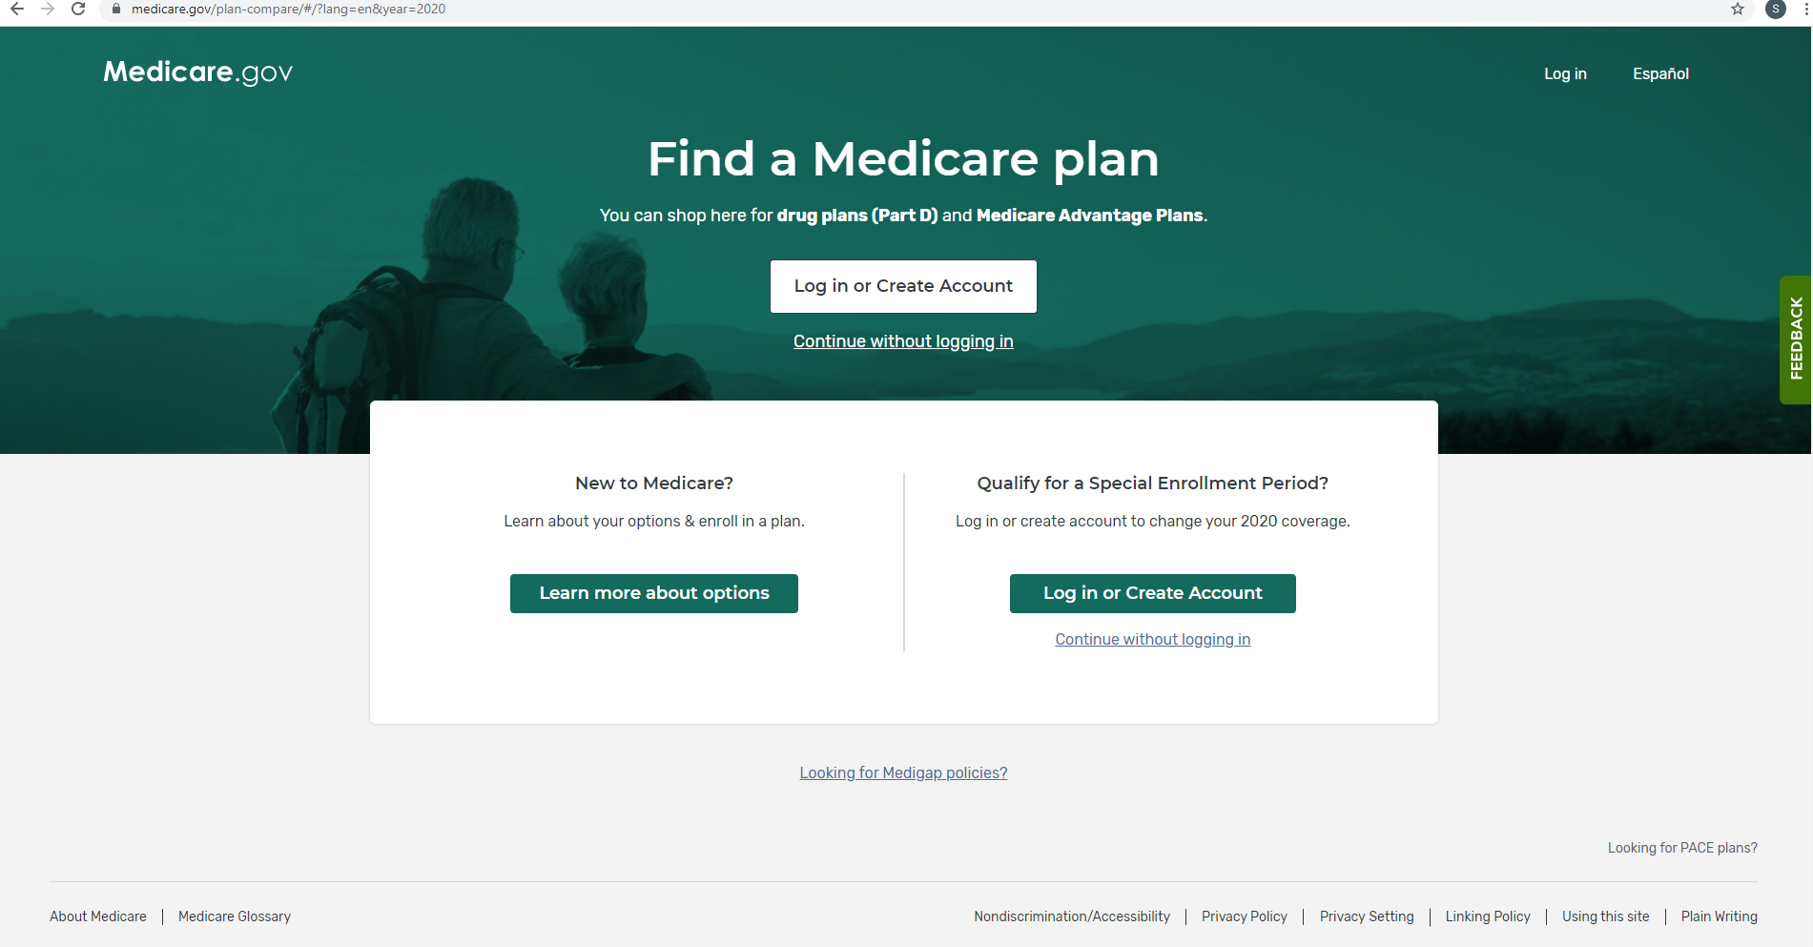
Medicare Plan Finder Homepage
To log in with an existing account or to create a new account
Click on "Log in or Create Account”
Note: you can click “Continue without logging in” to do an Anonymous search, but drug lists can’t be saved.

Slide 15
Medicare Advantage Open Enrollment Period
People in Medicare Advantage plans on January 1 can make one change January 1- March 31 of each year
Change from one MA to another MA plan or dis-enroll from MA plan and get stand-alone drug plan (and Medigap plan if needed)
Ex. Martha’s PCP belongs to a medical practice that drops Martha’s MA plan February 1. Martha can change to a different MA plan before 3/31 or go back to Original Medicare with or without a Medigap or drug plan

Slide 16
Part C and D Special
Enrollment Periods (SEP)
Can enroll, disenroll, or change Part C
(Medicare Advantage HMO or PPO) or Part D
Must have qualifying events or circumstances
Length of SEP depends on the qualifying event
Penalty may apply
5 Star plans or Prescription Advantage membership allow person to change plans 1x

Slide 17
Special SEP for Gov’t Entity-Declared Disaster or Other Emergency
Issued 08/12/2020
Effective/Implementation Date 01/01/2021
SEP available to individuals who were unable to make their elections during another valid election period due to the disaster/emergency

Slide 18
Programs that Can Help Pay Medicare and/or Drug Costs
MassHealth (Medicaid)
Medicare Savings Programs
Extra Help/Low Income Subsidy (LIS)
Prescription Advantage
Manufacturer plans, NeedyMeds.org etc
SHINE Counselors can help screen for these and other programs

Slide 19
Reminder: LIS SEP Limitations
Those on Extra Help/LIS and those with Dual eligibility (Medicare AND MassHealth, SCO) can only change plans one time per calendar quarter in the first 3 quarters of the year, not every month
Can change during 4th quarter in Fall OEP, for January effective date
Plan Finder will NOT indicate if beneficiary has already used SEP for current quarter
Dual eligible and LIS recipients retain the same right to utilize other SEPs such as change of LIS status, Fall AEP, moving out of a service area, 5 Star, etc.

Slide 20
Transitioning from the Health Connector to Medicare
For those in a Health Connector who become eligible for Premium free Medicare Part A (which means they earned 40 credits working under Social Security and paying into Medicare):
  They should sign up for Medicare
  They will lose their Health Connector coverage
  They will lose any tax credits they are receiving
  If they don’t sign up for Medicare, they may be subject to a late enrollment penalty

Slide 21
Ombudsman
Serves Medicare or MassHealth members enrolled in ACO, MCO, One Care, PACE, SCO
My Ombudsman helps resolve members’ issues and conflicts in many ways
My Ombudsman provides information, investigates, mediates, discusses options
Has only ASL Ombudsman in country
855-781-9898 info@myombudsman.org

Slide 22
Take Aways…
Don’t miss deadlines to sign up for Medicare
  Plans are improving notification to members approaching 65 through data matching
Dis-enroll from Health Connector plan by calling the plan
Remember to review Medicare plans every year during the Open Enrollment: 10/15 – 12/7

Slide 23

Where to Go For Help
Social Security Administration: 1-800-772-1213
  To enroll in Medicare
  www.ssa.gov
SHINE: (1-800-243-4636)
  English and Spanish
Medicare: 1-800-MEDICARE (1-800-633-4227)
MCPHS Pharmacy Outreach Program:
1-866-633-1617
  Review of meds & drug coverage, refers affordable prescription drug programs

