Slide 1
Health Connector
Response to COVID-19, Customer Experience Updates and Open Enrollment 2021 Preview
July 2020 Virtual MTF Meetings

Slide 2
Agenda
  Health Connector COVID-19 Response
  Health Connector Customer Experience Transition
  Health Connector Open Enrollment 2021 Preview

Slide 3
Health Connector COVID-19 Response

Slide 4
COVID-19 Special Enrollment Period (slide 1 of 3)
  The Health Connector’s Special Enrollment Period (SEP) for COVID-19 has been extended through July 23rd.
  The Massachusetts Health Connector announced an extension to its Special Enrollment Period (SEP) so that uninsured residents can apply and get into coverage.
    This SEP is available to anyone who is determined newly eligible or those previously determined eligible for any Health Connector plan but did not take advantage of their enrollment opportunity.
    They do not need to meet another qualifying event.
    Those enrolled in COBRA may drop it and enroll through the Health Connector, if they are otherwise eligible, without first exhausting their COBRA benefits.
The Division of Insurance has extended a similar SEP off-Exchange, which may be useful for those not eligible for the Health Connector.
Notes:
The new COVID-19 SEP is independent of any other SEP, and the only restriction on the COVID-19 SEP is that the individual is not already enrolled in a Health Connector plan. This is true regardless of who paid the first portion of your COBRA coverage (you or an employer) or your length of enrollment in COBRA. Keep in mind the COVID-19 SEP is currently set to end on July 23, 2020, which is also the enrollment and payment deadline for August 1 or September 1 coverage.

Slide 5
COVID-19 SEP (slide 2 of 3)
  Reminders about this SEP process:
  Applications for coverage can be submitted online or over the phone.
  People will get an automatic SEP – for example, those who are newly eligible for ConnectorCare.
  Encourage individuals to act now! This enrollment window is open through July 23rd for August 1 or September 1 coverage.
Notes:
If an automatic SEP is not visible (meaning members are not able to shop for a plan and enroll into coverage right away) members should contact Health Connector Customer Service to request a SEP due to COVID-19

Slide 6
COVID-19 SEP (slide 3 of 3)
  Remember, those who lose access to ESI or have a different qualifying event are eligible for an SEP that opens an enrollment window for 60 days.
  For the full list of qualifying events, go to: https://betterhealthconnector.com/wp-content/uploads/NG-05-Mid-Year-Life-Events.pdf

Slide 7
Updates on Requests for Information (RFI)
  In preparation for the Health Connector's Redeterminations and Renewals process MassHealth and the Health Connector will begin mailing reminder RFIs to households who still owe proof.
  Households with due dates in the past will be provided at least 30 more days to submit proof.
  Members who still owe proof can expect to see RFI letters at the end of July and into the beginning of August.
  If Health Connector members do not respond in the timeframe requested, their coverage may be downgraded or terminated.
  If the National Emergency is still in place at the time of the expiration, MassHealth members will maintain their MassHealth coverage during the COVID-19 public health national emergency, and through the end of the month in which such national emergency period ends.
  All members are encouraged to return proof of as soon as possible.

Slide 8
Health Connector
Customer Service Transition

Slide 9
Customer Experience Transition
The Health Connector has transitioned to new customer service vendors for operations. Members and Assisters will see most changes within the Member Portal.

Slide 10





New Features Now Available
^{New online}
^{payment}
^{experience}
^{Pay by phone anytime}
More payment choices with AutoPay
^{Ask for help}
^{online without having to call}
^{More content available}
^{in Spanish}
Notes:
Pay by phone with IVR will be available beginning July 6th.

Slide 11
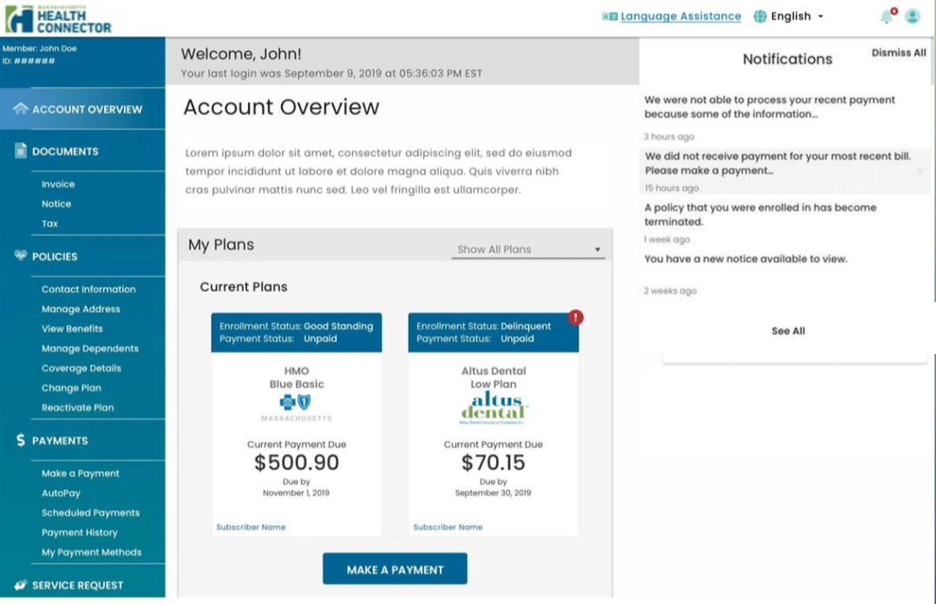
New online payment experience
Our payment site has a new, simpler look.

Slide 12
Pay by phone
Members can pay their premium by phone using their bank account.
Members can make a phone payment any time of day, even when our call center is closed.

Slide 13
More choices with AutoPay
Members can choose the 15th or the 23rd of each month for your payment withdrawal.
Members can also choose a set payment amount.
  If a member already has AutoPay, their payments will continue. Their payment will withdraw the 23rd of each month unless they change it.

Slide 14
With AutoPay Members select from these options:
Premium Amount
This option will take the member’s full monthly premium due. If their premium goes up due to a change in income, eligibility or plan enrollment, the higher premium amount will automatically be withdrawn.
Current Amount
This option will take the member’s full balance due. For example, if there is an outstanding balance or an adjustment that increases a member’s bill, this option will pay the full balance due automatically.
Custom Amount
This option lets the member selects the amount they would like the Health Connector to withdraw. The Health Connector will not take more than the fixed amount. This option can help protect a member from an unexpected amounts due to changes in eligibility.
Notes:
The downside of choosing Custom Amount is that the member will be delinquent and face termination if they aren't paying attention to their bills. If their eligibility changes, they would need to adjust their payment amount.

Slide 15
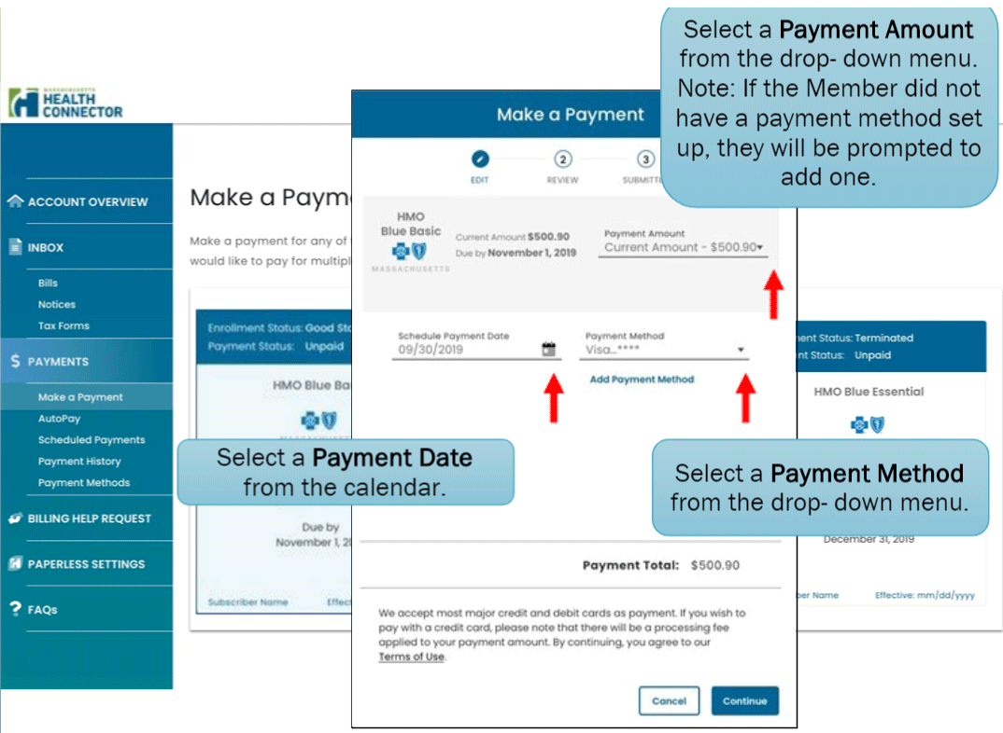
How to make a payment
Select a Payment Amount from the drop-down menu. Note: If the Member did not have a payment method set up, they will be prompted to add one.
Select a Payment Date from the calendar.
Select a Payment Method from the drop-down menu.
15

Slide 16
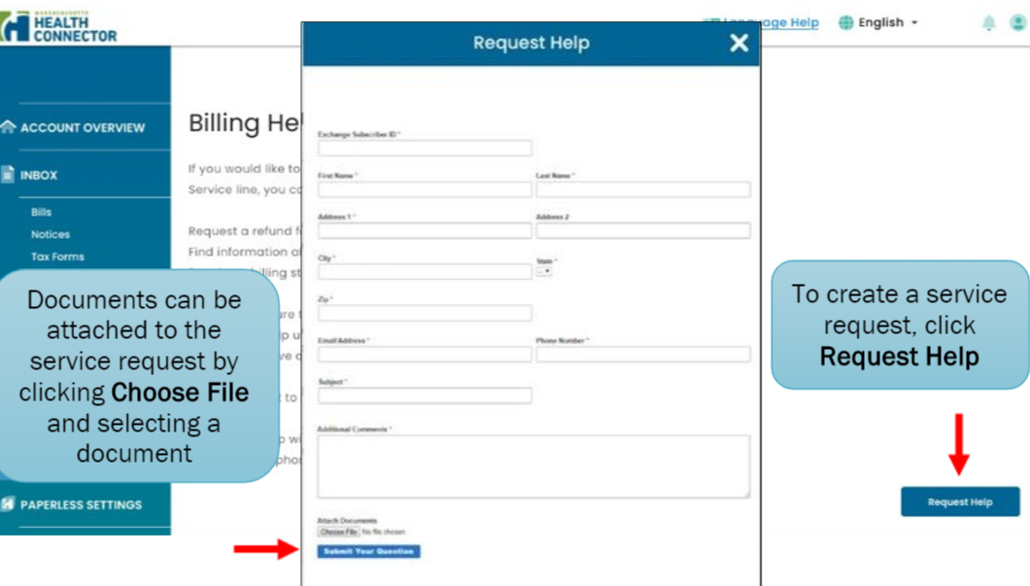
Ask for help online without having to call
Through their online account, members can ask Customer Service for help with certain billing questions.
Documents can be attached to the service request by clicking Choose File and selecting a document.
To create a service request, click Request Help.

Slide 17
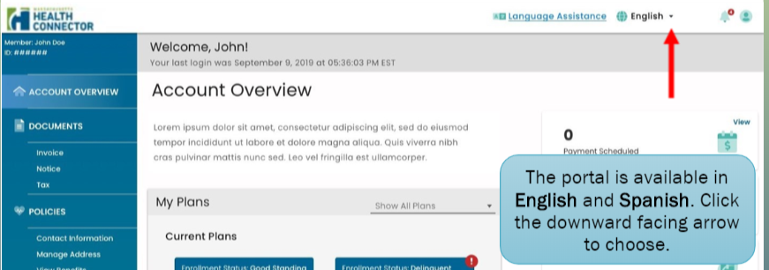
More content available in Spanish
You can change your language preference in your online account at any time.
The portal is available in English and Spanish. Click the downward facing arrow to choose.

Slide 18
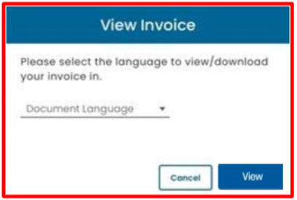
More content available in Spanish (continued)
Read your notices, bills, and your online account in Spanish if you prefer.

Slide 19
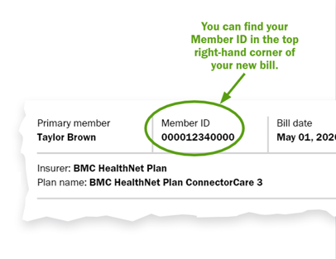
More Changes Related to Health Connector Member Payments
Changes to the way your bill looks
We hope you find the new bill easier to read and understand.
Changes when you pay your bill
You’ll use your Member ID to pay, and we have a new address.
Use your Member ID to make payments
You won’t need a separate Billing Account number for payments. Use your current Health Connector Member ID instead.
If you pay by mail, write your Member ID
on your check or money order.
If you pay on our website as a guest, we’ll
ask for your Member ID to find your account.
Use our new address to mail payments:
Health Connector
P.O. Box 412612
Boston, MA 02241-2612
You can find your Member ID in the top right-hand corner of your new bill.

Slide 20


More Changes Related to Health Connector Member Payments (continued)
If you mail payments
Our new address is on your bill’s payment slip. If you mail your payment using the envelope and payment slip that came with your bill, you’ll be all set.
If you pay directly through your bank
Be sure to update the payee information with our new payment address. If you need to enter an account number for your payment, enter your current Member ID instead of your Billing Account number.

Slide 21
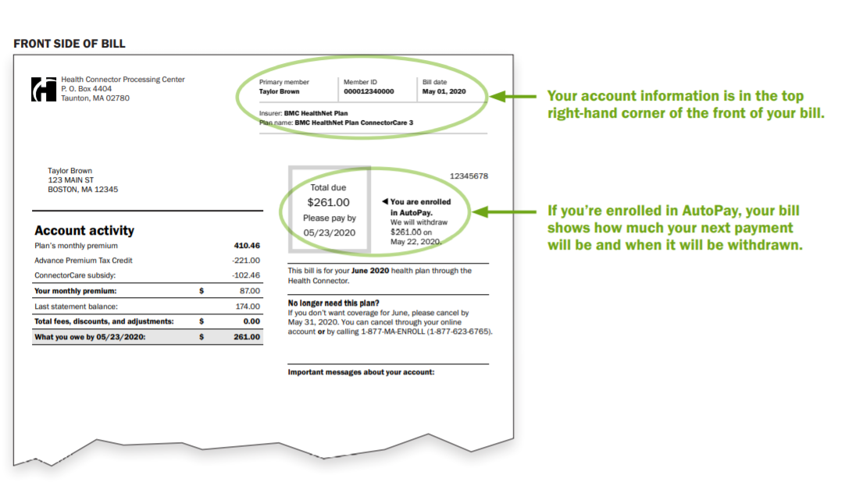
Features of New Health Connector Bill
Your account information is in the top right-hand corner of the front of your bill.
If you’re enrolled in AutoPay, your bill shows how much your next payment will be and when it will be withdrawn.

Slide 22
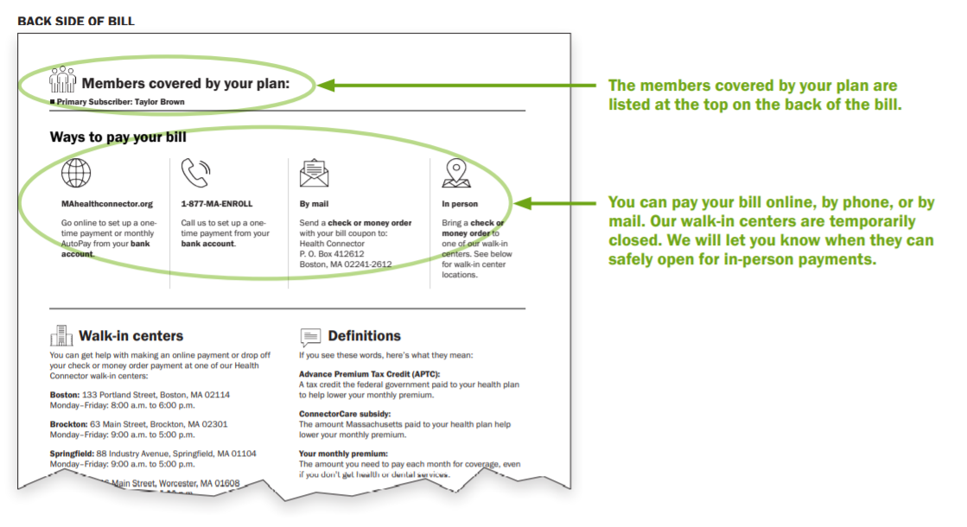
Features of New Health Connector Bill (continued)
The members covered by your plan are listed at the top on the back of the bill.
You can pay your bill online, by phone, or by mail. Our walk-in centers are temporarily closed. We will let you know when they can safely open for in-person payments.
Notes:
More changes and improvements are coming. We’ll keep you informed as they get closer.
For health and safety reasons, our walk-in centers will continue to stay closed. We will let you know when they are ready to re-open safely.

Slide 23
Health Connector Open Enrollment 2021 Preview

Slide 24
Open Enrollment 2021 Preview
The Health Connecter has started the planning process for
Open Enrollment 2021:
  Open Enrollment is the time when any new members can apply for coverage and current members' coverage is renewed for the upcoming year and can shop for plans.
  The Health Connector remains committed to offering our members and new enrollees a stable and well supported enrollment experience.
  Many of the processes and timelines for Open Enrollment 2021 will be the same as previous years.

Slide 25
Open Enrollment 2021 Preview (continued)
  However due to COVID-19, the following should be noted:
  The Federal and State Tax filing deadlines were extended to 7/15.
  Please encourage members who haven’t filed their taxes yet to do so online.
  Delay of the tax filing due date will delay determination of failure to reconcile past tax credits for 2019, but it is still requirement and will factor in to 2021 eligibility.
  The renewal process for mixed households will be sure to account for protections of MassHealth benefits under the CARES Act, assuming the federal public health emergency is ongoing.

Slide 26
Health Connector Redeterminations and Renewals Process

Slide 27
Redeterminations & Renewals
Processes and Timelines
The Health Connector’s Redetermination and Renewal Processes are a set of activities that happen each year before and during the Health Connector’s Open Enrollment period.
  Individuals with health insurance coverage through the
  Health Connector and MassHealth members on their households have their eligibility redetermined so that they can be renewed into coverage for the upcoming year.
Preliminary Eligibility Determination
Preliminary Eligibility Notice and Review Period
Final Eligibility Determination & Renewal Notice
Renewal into a Health Connector Plan
Billing and Payment for January 1 Coverage
August – September
August - October
October
November
December

Slide 28
Redeterminations and Renewals Process (slide 1 of 10)
  In August and September the Health Connector makes a preliminary eligibility determination for actively enrolled Health Connector members and Health Connector members who are part of mixed households.
Preliminary Eligibility Determination
August – September
  Mixed households are households that have both Health Connector members and MassHealth members.
  Available federal and state data sources are used to check for income and other factors.
    If a member has income that was verified with documents provided by the member within the last year, that income will be used for 2021.
28

Slide 29
Redeterminations and Renewals Process (slide 2 of 10)
Preliminary Eligibility Determination
  More detail on supporting Health Connector and MassHealth members:
August – September
  If the household has not verified their income in the last year and data sources are incompatible, Health Connector will make the determination using available electronic data sources.
    If household has not verified their income in the last year and data sources are compatible with the income we are using, we will continue to use the current (attested) income for 2021.
    If there is no available data because they have not filed taxes or there is no SSN, we will not be able to determine eligibility for MassHealth or Health Connector.
29

Slide 30
Redeterminations and Renewals Process (slide 3 of 10)
Preliminary Eligibility Determination
Health Connector members who are identified as Medicare eligible in their 2020 application will lose access to State and Federal subsidies.
August – September
  They can remain in an unsubsidized Health Connector plan through the end of the calendar year.
  These individuals will not be renewed for the upcoming year (they will lose their Health Connector health plan at the end of the calendar year).
  If they are enrolled in a Health Connector Dental plan, they will be eligible to stay enrolled in Dental for the next year.
30

Slide 31
Redeterminations and Renewals Process (slide 4 of 10)
Preliminary Eligibility Determination
Members should send in any verification documents they owe as soon as possible.
August – September
  Members who have outstanding verifications should send them prior to
  mid-August, if possible, as the verified information will help create the most accurate 2021 eligibility.
  Members who owe verifications when their preliminary eligibility is determined may see changes on their 2021 eligibility.
31

Slide 32
Redeterminations and Renewals Process (slide 5 of 10)
Preliminary Eligibility Notice and Review Period
  Notices with the results of the preliminary eligibility determination are sent in August and September to all Health Connector enrollees that applied for financial assistance.
August - October
  Households with only Health Connector members will get:
  Health Connector Preliminary Eligibility notice
Mixed Households will receive either a:
  Health Connector Preliminary Eligibility notice (for Mixed Households who can be auto-renewed); or a
  Combined (co-branded) Health Connector and MassHealth notice for Mixed Households with a MassHealth pre-populated form (for those Mixed Households who cannot be auto-renewed).
32

Slide 33
Redeterminations and Renewals Process (slide 6 of 10)
Preliminary Eligibility Notice and Review Period
  After members receive their Preliminary Eligibility notice, they have an opportunity to make changes before their determination is finalized for the next year.
August - October
  Depending on the type of household, the review period is between 30 – 45 days.
  Health Connector Households: 30 days to review application and make any changes before their renewal eligibility is finalized.
  Mixed Households that cannot be auto-renewed: Households that have both Health Connector and MassHealth members and get a MassHealth Pre-populated Renewal form have 45 days to review their application and make any changes before renewal eligibility is finalized .
    Those who are sent a pre-populated form are required to respond to MassHealth to provide updated information either online, by phone to MassHealth Customer Service or paper (mail or in-person).
  All members can make changes on their own online at any time.
33

Slide 34
Redeterminations and Renewals Process (slide 7 of 10)
Preliminary Eligibility Notice and Review Period
  More detail on supporting Health Connector and MassHealth members:
August - October
  Remember: When working with applicants who have “Pending” MassHealth benefits, encourage them to return their income verifications as soon as possible.
  Certain individuals who are pending MassHealth benefits will not receive a Pre-Populated Form or a Preliminary Eligibility notice.
  Please note these outlined MassHealth processes are only true in normal state in which the COVID-19 national emergency protections are not in place.
34
Notes:
This is the same process that was put into place last year. Overall, this process will remain in place and some individuals that would normally receive MH Pre-Populated Forms will not get them because they cannot be downgraded or termed from MH while COVID protections remain in place.

Slide 35
Redeterminations and Renewals Process (slide 8 of 10)
Final Eligibility Determination & Renewal Notice
  Eligibility is finalized after the 30-45 review period.
October
  In October a Final Eligibility and Renewal notice is sent to All households with at least one eligible and enrolled Health Connector health plan member that continues to be eligible for a Health Connector plan the following year.
  This notice will include the health plan name and premium for the upcoming year, and their APTC amount.
  Those who were determined eligible but not enrolled and got a 2021 application will get a 2021 eligibility notice during this timeframe. It will not include any renewal information.
35

Slide 36
Redeterminations and Renewals Process (slide 9 of 10)
Renewal into a Health Connector Plan
  Open Enrollment begins on November 1st. The Health Connector follows guidelines to place members into their dental and medical plans each year.
November
  The Health Connector will renew members into the same plan for 2021, unless that plan is no longer available to them. If their plan is no longer available, the Health Connector will put them into a similar plan.
  All Health Connector eligible and enrolled QHP (qualified health plan) members who continue to be eligible for January 1 will be auto renewed into a plan.
  During Open Enrollment, members can shop for and select new plans for the next year if they do not want to be renewed into their current plan.
  Remember: Medicare individuals will not be renewed into a Health Connector medical plan for 2021. They will lose eligibility for QHP (including unsubsidized coverage) at the end of the year.
36

Slide 37
Redeterminations and Renewals Process (slide 10 of 10)
Billing and Payment for January 1 Coverage
  For coverage effective January 1, 2021, payment is due on December 23, 2020.
December
  Members that stay in a plan with the same carrier must pay their new premium amount for January coverage.
  If the member decides to change carriers, they are required to submit a binder payment to their new plan for January coverage.
  Note: New billing change this year related to member account numbers. Regardless of whether or not the member changes carriers, they will continue to use their same member ID. (This number starts with a “7” and is located in the upper right-hand corner of their bill.)
37

Slide 38
What can members expect after the COVID-19 emergency has passed?
  ​​Members that were protected in benefits due to CARES act will continue with those protections until end of the month when the national emergency ends.
  Heath Connector and MassHealth are working on planning these related process and will keep you updated.

Slide 39
Questions

